Slide 1

Advancing Million Hearts®:
AHA and State Heart Disease and Stroke
Partners Working Together in South Dakota
July 11, 2017
9:00 AM to 3:00 PM CT
Holiday Inn, Sioux Falls City Centre
100 W. 8th St.
Sioux Falls, South Dakota

Slide 2
Welcome & Overview of the Day
Julie Harvill, Operations Manager
Million Hearts® Collaboration
John Clymer, Executive Director
National Forum for Heart Disease and Stroke Prevention
Co-Chair, Million Hearts® Collaboration

Slide 3
Expectations-Approach for the Day
John Bartkus, Principal Program Manager, Pensivia

Slide 4
Introductions:
Name
Organization
What excites you about your role
in heart disease and stroke prevention?
(one sentence)

Slide 5
Logistics – Preparing for Afternoon Breakouts
1 IMPROVE DATA COLLECTION | 2 PRIORITY POPULATIONS | 3 CONTINUUM OF CARE | 4 PREVENTION & MANAGEMENT
Ashley Miller Stan Kogan Whitney Garney Robin Rinker Mallory Stasko | Kiley Hump Julia Schneider April Wallace Linda Stopp | Megan Myers Julie Harvill Mary Jo Garofoli | Katie Hill Miriam Patanian John Clymer Holly Arends
ACTION: Before lunch is over,
please add your name to the Flip-chart
for the Session you plan to attend.

Slide 6
A key focus for the day…
ALIGNMENT

Slide 7
Activity
“We’re all Arrows”
Look around the room.
Identify something to focus on.
Close your eyes.
Fully extend your arm to point at it.
(Watch out for your neighbors)
Notes:
Million Hearts® is a national initiative that aims to prevent 1 million heart attacks, strokes, and other cardiovascular events* over the next five years.
This national initiative is co-led by the Centers for Disease Control and Prevention and the Centers for Medicare and Medicaid Services and carried out by a variety of governmental and non-governmental partners at local, state, and federal levels.
Million Hearts® provides a platform to shine light on a selection of evidence-based strategies for cardiovascular disease prevention, and serves as a learning lab and repository of tools, protocols, and resources for partners to use to implement these strategies. The only way we—as a nation—will meet these goals is through the collective and focused action of a variety of partners. In short, Million Hearts® provides the foundation and tools, and the Million Hearts® partners build the house.
*Within the Million Hearts® initiative, for plain language purposes, we often say “heart attacks and strokes,” but the definition of prevented cardiovascular events that we track is broader than that and includes deaths, hospitalizations, and emergency room visits from heart attack, stroke, transient ischemic attack, and heart failure, as well as other cardiovascular events.

Slide 8







Outcome?

Slide 9

Alignment
Coordination of
Purpose, Focus and Energy

Slide 10
Alignment
Coordination of
Purpose, Focus and Energy
Higher Impact on the target

Slide 11
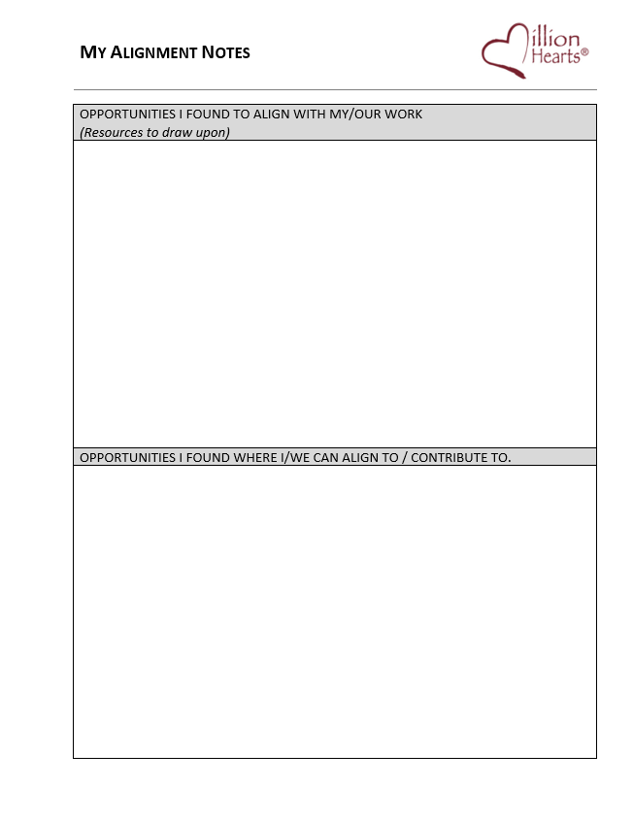
One of the sheets in your packet is
“My Alignment Notes”
Opportunities I found to:
* Align with My work
* Align with Others work
If “Alignment” is a key goal of this meeting, then what would evidence of cultivating alignment be?

Slide 12
Preventing 1 Million Heart Attacks and Strokes by 2022
Robin Rinker, MPH
Health Communications Specialist
Division for Heart Disease and Stroke Prevention
Centers for Disease Control and Prevention
Notes:
I work for the DHDSP, the nation’s public health leader in CVD Prevention
We fund all states, some local health departments and tribal organizations for prevention of CVD-including a $863,000 investment in SD in FY16
Coverdell funds 9 states to set up stroke registries and make improvements across the care continuum
Fund the Wisewoman program to provide low income and uninsured women with chronic disease risk factor screening and referrals
In addition to our funded programs, we track data and trends on CVD risk factors
We conduct research to guide practice and create products so funded programs can be effective
Million Hearts is on component of many, but is a critical national platform for a focused set of public health and clinical CVD prevention strategies

Slide 13
Million Hearts® 2022
Aim: Prevent 1 million—or more—heart attacks and strokes in the next 5 years
National initiative co-led by:
  Centers for Disease Control and Prevention (CDC)
  Centers for Medicare & Medicaid Services (CMS)
  Partners across federal and state agencies and private organizations
Notes:
Million Hearts® is a national initiative that aims to prevent 1 million heart attacks, strokes, and other cardiovascular events* over the next five years.
This national initiative is co-led by the Centers for Disease Control and Prevention and the Centers for Medicare and Medicaid Services and carried out by a variety of governmental and non-governmental partners at local, state, and federal levels.
Million Hearts® provides a platform to shine light on a selection of evidence-based strategies for cardiovascular disease prevention, and serves as a learning lab and repository of tools, protocols, and resources for partners to use to implement these strategies. The only way we—as a nation—will meet these goals is through the collective and focused action of a variety of partners. In short, Million Hearts® provides the foundation and tools, and the Million Hearts® partners build the house.
*Within the Million Hearts® initiative, for plain language purposes, we often say “heart attacks and strokes,” but the definition of prevented cardiovascular events that we track is broader than that and includes deaths, hospitalizations, and emergency room visits from heart attack, stroke, transient ischemic attack, and heart failure, as well as other cardiovascular events.

Slide 14
Heart Disease and Stroke in the U.S.
More than 1.5 million people in the U.S. suffer from heart attacks and strokes per year¹
More than 800,000 deaths per year from cardiovascular disease (CVD)¹
CVD costs the U.S. hundreds of billions of dollars per year¹
CVD is the greatest contributor to racial disparities in life expectancy²
References
1. Benjamin EJ, Blaha MJ, Chiuve SE, Cushman M, Das SR, Deo R, et al. Heart Disease and Stroke Statistics-2017 Update: A Report From the American Heart Association. Circulation 2017;135(10):e146–603.
2. Kochanek KD, Arias E, Anderson RN. How did cause of death contribute to racial differences in life expectancy in the United States in 2010? NCHS data brief, no 125. Hyattsville, MD: National Center for Health Statistics. 2013
Notes:
Each year, in the United States, more than 800,000 adults die from cardiovascular disease, and 1.5 million have a heart attack or stroke.¹
Cardiovascular disease is the leading cause of potentially preventable death in the U.S.²
The cost to the U.S. economy is over $300 billion every year in medical costs and lost productivity. ¹
Cardiovascular disease is the greatest contributor to racial disparities in life expectancy among African Americans—accounting for more than one year of the almost four years shorter life span.³
And most alarmingly, after 40 years of steady improvement, the rates of decline in both heart disease and stroke deaths have slowed.⁴
SD ranks 21st in the nation in heart disease mortality per 100,000 and has a stroke mortality rate of 4% higher than the national average.

Slide 15
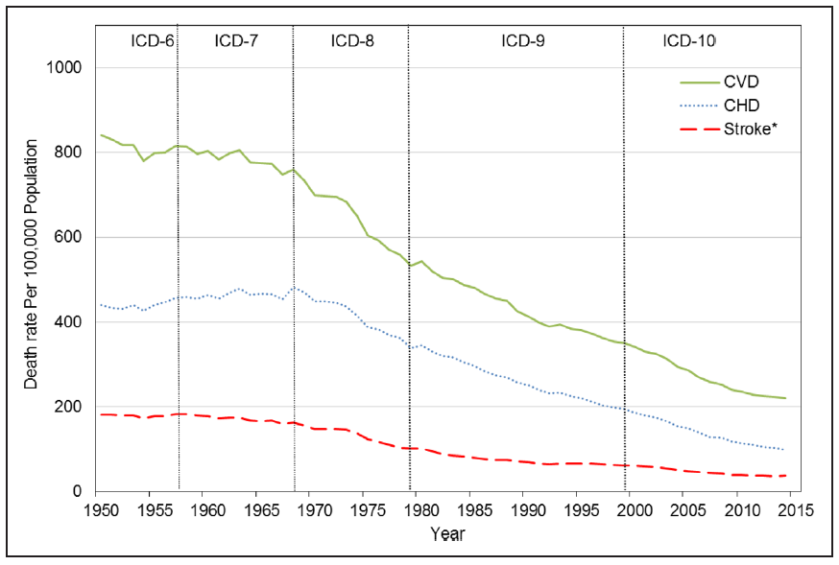
Heart Disease and Stroke Trends
1950-2015
While CV deaths have been declining for the past 40 years, the reduction in these deaths has slowed.
Source – Mensah GA, Wei GS, Sorlie PD, et al. Decline in Cardiovascular Mortality – Possible Causes and Implications. Circulation Research. 2017;120:366-380.
Notes:
Deaths due to heart attacks and strokes have been declining steadily for the last 40 years, which can be attributed to both changes in the environment (such as having fewer people smoking) and to improvements in clinical care (such as improved care for those having a stroke and medication use for those with high blood pressure and high cholesterol).⁴
This graph shows the rate of cardiovascular deaths since 2000, and you can see that there is a flattening (or lessening) of the decline. The flattening of the decline is worrying and warrants focusing the Million Hearts® initiative on priorities and strategies to reverse this troubling trend.

Slide 16

Million Hearts® 2022
Aim: Prevent 1 Million Heart Attacks and Strokes in 5 Years
Keeping People Healthy
Optimizing Care
COMMUNITY
Priority Populations
Notes:
To prevent 1 million heart attacks and strokes by 2022, we need to focus on three key priorities:
Keeping people healthy by making changes to the environments in which people live, learn, work, and play to make it easier for people to make healthy choices.
Optimizing care so that those with and at risk for cardiovascular disease receive the services and acquire the skills needed to reduce the likelihood of having a heart attack or stroke.
Improving outcomes for priority populations who suffer worse outcomes of cardiovascular disease and where there is evidence and the opportunity to make a significant impact.

Slide 17
Million Hearts® 2022
Priorities
Keeping People Healthy
Reduce Sodium Intake
Decrease Tobacco Use
Increase Physical Activity
Optimizing Care
Improve ABCS*
Increase Use of Cardiac Rehab
Engage Patients in Heart-healthy Behaviors
Improving Outcomes for Priority Populations
Blacks/African Americans
35- to 64-year-olds
People who have had a heart attack or stroke
People with mental illness or substance use disorders
*Aspirin use when appropriate, Blood pressure control, Cholesterol management, Smoking cessation
Notes:
Bold and specific action is needed if we are to prevent 1 million events.
Preventing 1 million events is possible by achieving a 20% reduction in sodium, smoking, and physical inactivity in our communities.
The health care contribution to the million or more comes from achieving 80% performance on key clinical quality measures of cardiovascular care, the ABCS:
Aspirin use or other anticoagulants as appropriate,
Blood pressure control,
Cholesterol management, and
Smoking cessation.
With less than 30% of those eligible for cardiac rehabilitation being referred and enrolled, the goal for cardiac rehab has been set at participation rates of 70%. Achieving this 5-year goal would prevent 25,000 deaths and 180,000 hospitalizations annually.⁵ 5.1% of SD adults have had a hear attack (2014)
Helping people practice healthy habits starts in the community, with good design, ready access, and peer group activities, and is reinforced by clinicians who equip and empower their patients to adopt heart-healthy behaviors.
Finally, certain populations suffer worse cardiovascular outcomes, and while the reasons for these disparities are complex, effective interventions are now available to help narrow these gaps. Therefore, “improving outcomes for priority populations” has been established as a new priority for this phase of the initiative.

Slide 18
Keeping People Healthy
Goals | Effective Public Health Strategies
Reduce Sodium Intake Target: 20% | Enhance consumers’ options for lower sodium foods Institute healthy food procurement and nutrition policies
Decrease Tobacco Use Target: 20% | Enact smoke-free space policies that include e-cigarettes Use pricing approaches Conduct mass media campaigns
Increase Physical Activity Target: 20% (Reduction of inactivity) | Create or enhance access to places for physical activity Design communities and streets that support physical activity Develop and promote peer support programs
Notes:
To get to the goal of a 20% reduction in sodium intake, smoking, and physical inactivity, we must focus our collective efforts on effective public health strategies.
Strong evidence suggests local food procurement policies can enhance consumer choice for lower sodium foods, while encouraging more producers to offer lower sodium alternatives.
Smoke-free spaces and pricing approaches are effective in driving down tobacco use.
And there is promising evidence that increasing access to places for physical activity, designing communities and streets with physical activity in mind, and peer support–type walking groups can help more individuals increase their physical activity level.

Slide 19
Optimizing Care
Goals | Effective Health Care Strategies
Improve ABCS* Targets: 80% | High Performers Excel in the Use of… Teams—including pharmacists, nurses, community health workers, and cardiac rehab professionals Technology—decision support, patient portals, e- and default referrals, registries, and algorithms to find gaps in care Processes—treatment protocols; daily huddles; ABCS scorecards; proactive outreach; finding patients with undiagnosed high BP, high cholesterol, or tobacco use Patient and Family Supports—training in home blood pressure monitoring; problem-solving in medication adherence; counseling on nutrition, physical activity, tobacco use, risks of particulate matter; referral to community-based physical activity programs and cardiac rehab
Increase Use of Cardiac Rehab Target: 70%
Engage Patients in Heart-healthy Behaviors Targets: TBD
*Aspirin use when appropriate, Blood pressure control, Cholesterol management, Smoking cessation
Notes:
Likewise, in order to achieve excellence in clinical care, we need to focus on effective health care strategies.
Evidence has shown that high performers excel in the use of:
Teams, including pharmacists, nurses, community health workers, and cardiac rehab teams. The nation needs everyone working at the top of their license and abilities.
Technology, such as electronic health records that include clinical decision support, patient portals, e- and default referrals, registries, and algorithms to find gaps in care.
Processes that ensure quality care, such as treatment protocols; daily huddles of the medical team; scorecards that show performance status on the ABCS; proactive outreach to patients about their risks, such as uncontrolled high blood pressure; and finding patients with undiagnosed high blood pressure, high cholesterol, or tobacco use.
Patient and family supports, such as training in self-measured blood pressure monitoring; problem-solving in medication adherence; counseling on nutrition, physical activity, tobacco cessation, and avoiding exposure to particulate matter (also known as particle pollution); and systematic referrals to community-based physical activity and cardiac rehab programs.

Slide 20
Improving Outcomes for Priority Populations
Priority Population | Intervention Needs | Strategies
Blacks/African Americans | Improving hypertension control | Targeted protocols Medication adherence strategies
35-64 year olds | Improving HTN control and statin use Decreasing physical inactivity | Targeted protocols Community-based program enrollment
People who have had a heart attack or stroke | Increasing cardiac rehab referral and participation Avoiding exposure to particulate matter | Automated referrals, hospital CR liaisons, referrals to convenient locations Air Quality Index tools
People with mental illness or substance abuse disorders | Reducing tobacco use | Integrating tobacco cessation into behavioral health treatment Tobacco-free mental health and substance use treatment campuses Tailored quitline protocols

Slide 21
Million Hearts®
Resources and Tools
Action Guides—Hypertension control; Self-measured blood pressure monitoring (SMBP); Tobacco cessation; Medication adherence
Protocols—Hypertension treatment; Tobacco cessation; Cholesterol management
Tools—Hypertension prevalence estimator; ASCVD risk estimator
  Health IT
Clinical Quality Measures
Consumer Resources and Tools
Notes:
Million Hearts® can help you take action to reach these goals and implement these strategies. The initiative’s website offers many resources and tools designed to help partners take action to reach the goals of Million Hearts®.
These include Action Guides on hypertension control, self-measured blood pressure monitoring (SMBP), tobacco cessation, and medication adherence; protocols for hypertension treatment, tobacco cessation, and cholesterol management; tools such as the Hypertension Prevalence Estimator and the ASCVD Risk Estimator; resources related to using Health IT; information on Clinical Quality Measures, including the measures themselves and a clinical quality measures dashboard; and consumer resources and tools. To learn more about the audience and purpose of each of these resources, please visit the Million Hearts® website at millionhearts.hhs.gov.

Slide 22
Partner Opportunities: Hospitals
Sample Actions to Consider
Action: Make healthy food and beverage choices available to patients, visitors, and staff
  Resource: HHS/GSA Health and Sustainability Guidelines for Federal Concessions and Vending Operations
  Success Story: Sodium Reduction Community Program Los Angeles County Department of Public Health
Action: Implement comprehensive smoke-free policies
  Resource: The Community Guide: Tobacco Use and Secondhand Smoke Exposure: Smoke-Free Policies
  Success Story: Communities Putting Prevention to Work: Tobacco Use Prevention and Control
Action: Institute automatic referral of eligible patients to cardiac rehab
  Resource: Increasing Cardiac Rehabilitation Participation From 20% to 70%: A Road Map From the Million Hearts Cardiac Rehabilitation Collaborative
Notes:
“Thank you, Cynthia, Shaquana, and Dina. We hope that some of you see your organizations in the actions already presented today. For those of you for whom the sector or focus is different, we are working on other examples like these. We have pulled just a few of many example actions partner can take and paired them with resources and examples of each. A collection of actions like this, appropriate to your organization and aligned with your mission and goals, will serve as a commitment to MH.
For example, hospitals can work on healthy food and beverage choices, implement smoke-free policies, and institute cardiac rehab ‘opt out’ referral

Slide 23
Partner Opportunities: Employers
Sample Actions to Consider
Action: Make healthy food and beverage choices available to all employees
  Resource: HHS/GSA Health and Sustainability Guidelines for Federal Concessions and Vending Operations
  Success Story: Sodium Reduction Community Program Los Angeles County Department of Public Health
Action: Develop and support policies at worksites to encourage use of tobacco cessation services.
  Resource: The Community Guide: Tobacco Use and Secondhand Smoke Exposure: Quitline Interventions
  Success Story: North Carolina Division of Public Health, Tobacco Prevention and Control Branch: Expanding Comprehensive Coverage for Tobacco Cessation
Action: Provide environmental supports for recreation or physical activity (e.g., onsite exercise facility, walking trails, bicycle racks).
  Resource: CDC Worksite Health ScoreCard
  Success Story: Bike Share Program Offers California State Employees Another Way to Be Active
Notes:
Here are some examples of actions employers can take:

Slide 24
Partner Opportunities: Clinical Care Teams
Sample Actions to Consider
Action: Use standardized treatment protocols for hypertension treatment, tobacco cessation, and cholesterol management
  Resource: CDC: Million Hearts® Protocols
  Success Story: 2014 Hypertension Control Champions: Large Health Systems
Action: Implement self-measured blood pressure monitoring (SMBP) interventions with clinical support
  Resource: Million Hearts® Self-Measured Blood Pressure Monitoring: Action Steps for Clinicians
  Success Stories: 2013 Hypertension Control Champion: Nilesh V. Patel, MD; 2015 Hypertension Control Champion: Reliant Medical Group
Action: Improve performance on Million Hearts® clinical quality measures on aspirin, BP control, cholesterol, smoking cessation, and cardiac rehab
  Resource: Million Hearts® ABCS measures
  Success Story: Association of State and Territorial Health Officials (ASTHO) Million Hearts Minnesota
Action: Leverage electronic health record (EHR) systems to excel in the ABCS
  Resource: Million Hearts® EHR Optimization Guides
  Success Story: Michigan Center for Effective IT Adoption
Notes:
Clinical care teams can:

Slide 25
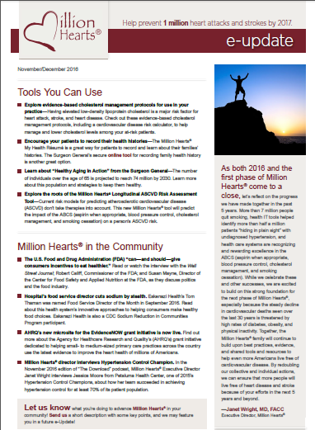
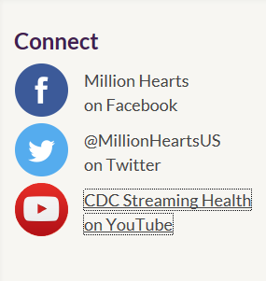
Stay Connected
  Million Hearts® eUpdate Newsletter
  Million Hearts® on Facebook and Twitter
  Million Hearts® Website
  Million Hearts® for Clinicians Microsite
Notes:
Spread the word, share with your networks, and check out the resources and tools on the Million Hearts® website.

Slide 26
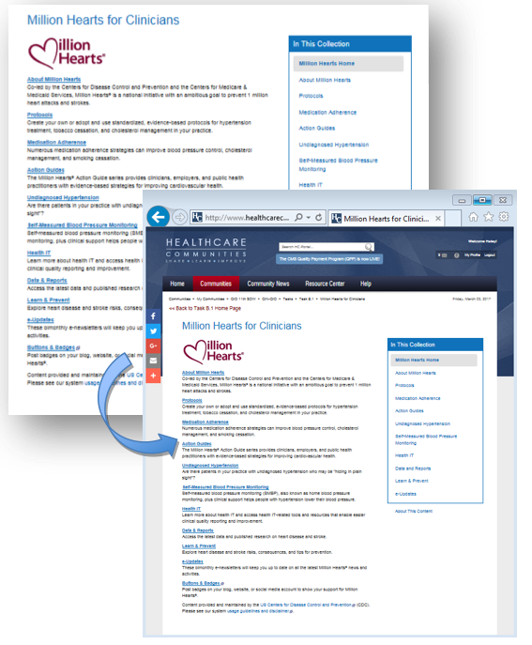
Million Hearts® for Clinicians Microsite
Features Million Hearts® protocols, action guides, and other QI tools
Syndicates LIVE Million Hearts® on your website for your clinical audience
Requires a small amount of HTML code—customizable by color and responsive to layouts and screen sizes
Content is free, cleared, and continuously maintained by CDC
Available at https://tools.cdc.gov/medialibrary/index.aspx#/microsite/id/279017
Notes:
(optional slide)
If you are presenting to organizational chapters or suborganizations that manage their own website(s), please pitch this resource on behalf of Million Hearts® using this slide and the language provided below.
An easy first step to support Million Hearts® is to embed the Million Hearts® microsite on your organization’s webpage. It’s an easy and cost-free way to make high-impact and up-to-date Million Hearts® clinical resources—including evidence-based protocols, action guides, quality improvement tools, and other featured resources and references—available to your clinical audiences.
If your organization has already embedded the microsite, feel free to feature a print screen of your webpage with the microsite and share this resource by stating, “We feature the Million Hearts® for Clinicians microsite on our website at _____. Please direct our partnered clinicians to this webpage for their convenience in reviewing the Million Hearts® messages and tools they can use in their delivery of care.”

Slide 27
Q & A
Group Interaction

Slide 28
Break

Slide 29

KILEY HUMP, ADMINISTRATOR
OFFICE OF CHRONIC DISEASE PREVENTION AND HEALTH PROMOTION

Slide 30

DOH Strategic Plan
2015-2020
Vision
Healthy People
Healthy Communities
Healthy South Dakota
To promote, protect and improve the health of every South Dakotan
Serve with integrity
Eliminate health disparities
Demonstrate leadership and accountability
Focus on prevention and outcomes
Leverage partnerships
Promote innovation
mission
Guiding principals

Slide 31






Good & Healthy south dakota
Office of Chronic Disease Prevention and Health Promotion

Slide 32
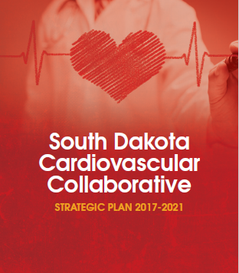
The Cardiovascular Collaborative
A group of medical and public health representatives who want to improve the quality of life for all South Dakotans through prevention and control of heart disease and stroke.

Slide 33
Leadership Team
Kiley Hump
Amanda Keefe
Marty Link
Mary Michaels
Ashley Miller
Megan Myers
Holly Arends
Kevin Atkins
Mandi Atkins
Stacie Davis
Mark East
Colette Hesla
Katie Hill
*Have a conference call quarterly

Slide 34




Collaborative Planning Process
Key Informant Interviews
Stakeholder Survey
In-Person Meeting July 2016
Prioritize Strategies

Slide 35
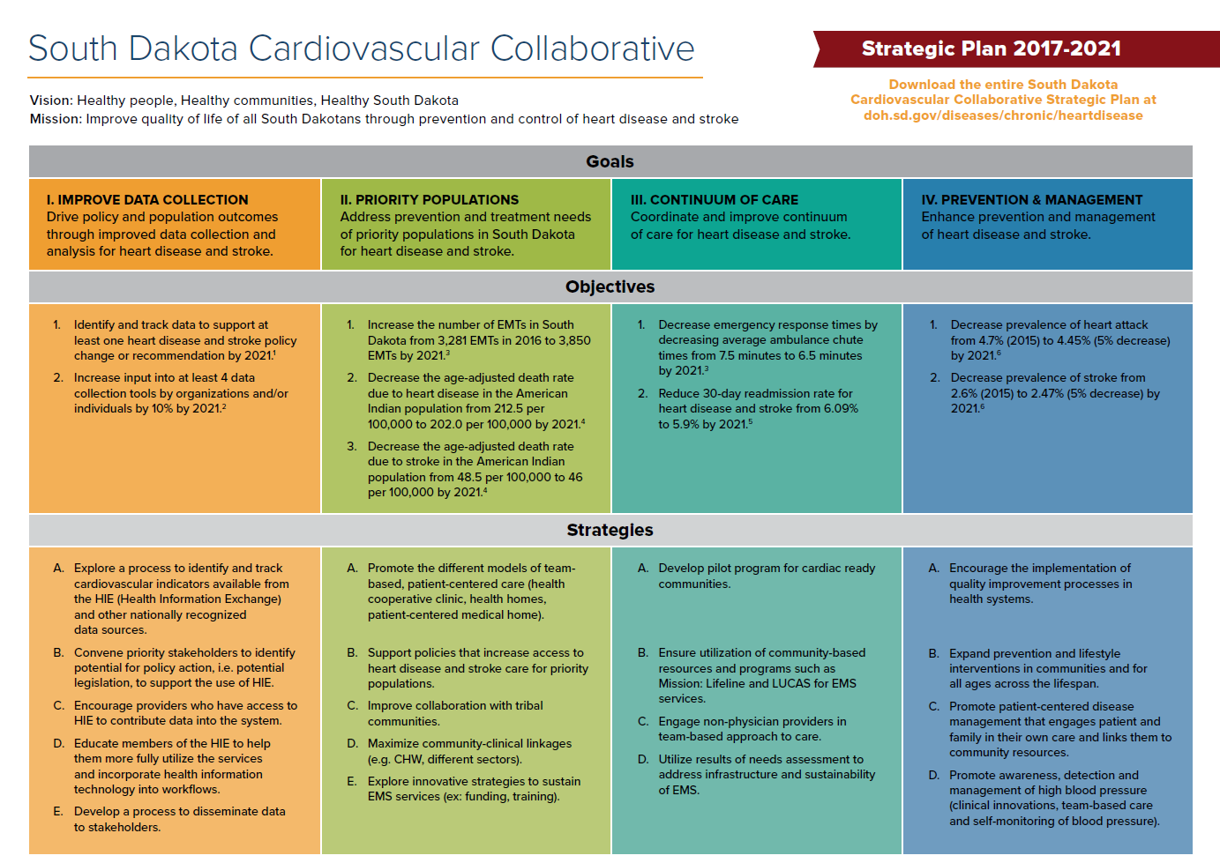

Slide 36
Year 1 Implementation
In-person Action Planning meeting March 2017
Selected Year 1 Priority Strategy in each goal area
Workgroup calls
Advancing Million Hearts Conference

Slide 37
Q & A
Group Interaction

Slide 38
Improving Cardiac Care- the Great Plains States
Holly Arends, Program Manager
South Dakota Foundation for Medical Care

Slide 39
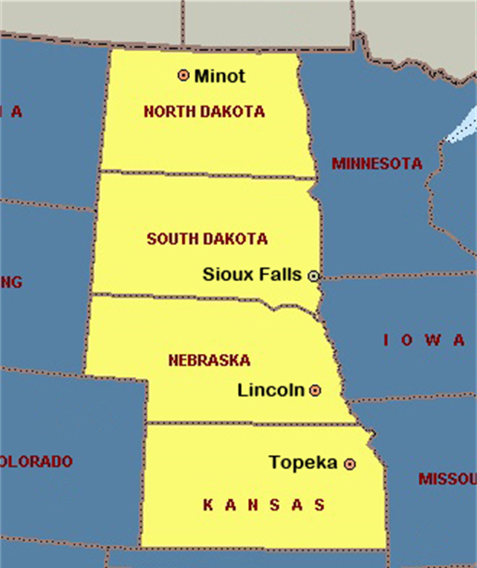
Great Plains Quality Innovation Network (GPQIN)
Antibiotic Stewardship
Cancer Prevention
Cardiac Health
Care Coordination
Diabetes Care
Healthcare Infections
Immunizations
Medication Safety
Nursing Home Care
Quality Payment Program
Transforming Clinical Practice
Colorectal Cancer Screening

Slide 40
Triple AIM Approach to Clinical Quality
Foundation Principles:
Enable innovation
Foster learning organizations
Eliminate disparities
Strengthen infrastructure and data systems
  Better Health
  Better Care
  Lower Cost

Slide 41
Our Approach
Align with the Million Hearts® Initiative (www.millionhearts.hhs.gov) to improve preventive care measures, including aspirin use, blood pressure control, cholesterol management and smoking/tobacco education
We will target disparate populations, including gender, racial and ethnic disparities and rural, to improve cardiac health

Slide 42
Our Approach
Focus on the ABCS
  Measure monitoring
    HHQI
    MIPS Calculator
    Practice Pattern Variance
  Data driven QI
  Optimizing utilization of HIT
  Support innovations in care delivery

Slide 43
Cardiovascular Health and Million Hearts®
Our planned improvement efforts align with the national Million Hearts® initiative that seeks to prevent one million heart attacks and strokes by 2022.
Heart disease and stroke are the first- and fourth- leading causes of death¹
Heart disease and stroke cost more than $312.6 billion in healthcare expenditures and lost productivity annually²
Centers for Disease Control and Prevention
Million Hearts®

Slide 44
Our Approach
Offering technical assistance on the Physician Quality Reporting System (PQRS) cardiovascular measures submission for participating clinics
Assist home health agencies with measures reporting through the Home Health Cardiovascular Data Registry
Help clinics utilize EHRs for data analysis and performance improvement activities focused on clinical quality measures

Slide 45
South Dakota Performance

Slide 46
Contact Information
Holly Arends, CMQP
Program Manager
Great Plains QIN/ SDFMC
P: 605.660.5436
Holly.Arends@area-a.hcqis.org
This material was prepared the Great Plains Quality Innovation Network, the Medicare Quality Improvement Organization for Kansas, Nebraska, North Dakota and South Dakota, under contract with the Centers for Medicare & Medicaid Services (CMS), an agency of the U.S. Department of Health and Human Services. The contents presented do not necessarily reflect CMS policy. 11S0W-GPQIN-GEN-01/0914

Slide 47
Q & A

Slide 48


Overview of the
American Heart Association and
Programs and Resources
that align with Million Hearts®
  Megan Myers
  SD Government Relations Director

Slide 49
Mission
Building healthier lives, free of cardiovascular diseases and stroke.
Our 2020 Impact Goal
By 2020 to improve the cardiovascular health of all Americans by 20% while reducing deaths from cardiovascular diseases and stroke by 20%.
Notes:
Set tone – here is our mission
Our 2020 impact goal
Factors we are looking at to get at improved cardiovascular health of all Americans by 2020
- A mixture of health factors and health behaviors – otherwise known as life simple 7:
- Smoking, physical activity, health diet, bmi, cholesterol, blood pressure, glucose

Slide 50
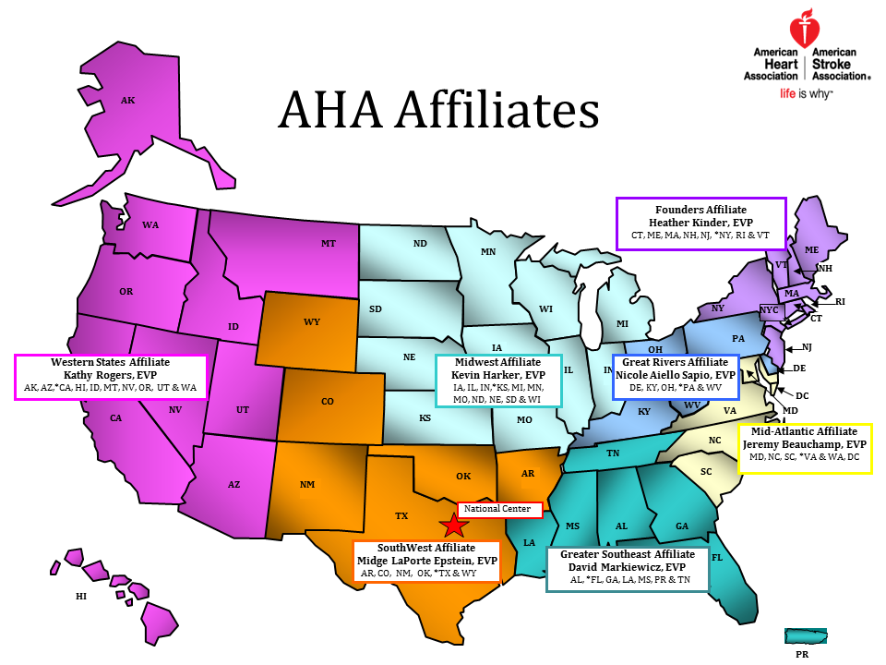
Notes:
Structure
Headquarters Dallas
seven affiliates
3,000 staff members;
150 office across the country
Each office slightly different
Roles may include:
Advocacy
Communications
Community Health
Development
Leadership
Multicultural
Quality
Other
Address VA

Slide 51
Building a Culture of Health
A culture in which people live, work, learn, play and pray in environments that support healthy behaviors, timely quality care and overall well-being.
Notes:
Building a culture of health –
To achieve this, we must work together, in partnership to make the healthy choice the easy choice in all the places where we live, work, learn, play, pray and heal.
To impact millions, we must focus on more than just individual behavior change
Need scalable, sustainable, and equity-addressing solutions.
Focus on focus on improving environments through policy and systems change and address social determinants of health

Slide 52

AHA and Million Hearts®
Spotlight on South Dakota
Quality & Systems Improvement Priorities
  Get With The Guidelines & Mission: Lifeline Quality Awards
    Avera Heart Hospital of South Dakota
    Sanford USD Medical Center
    Rapid City Regional Hospital
Notes:
Will discuss the different projects/ policies AHA is focused on and potential for collaboration with partners

Slide 53
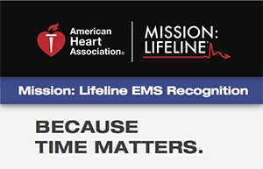
AHA and Million Hearts®
Spotlight on South Dakota
Quality & Systems Improvement Priorities
  2017 Mission: Lifeline EMS Recognition
    Paramedics Plus – Sioux Falls
      Sioux Falls Fire Rescue
      Sioux Falls Police
    Moody County Ambulance - Flandreau
Notes:
Will discuss the different projects/ policies AHA is focused on and potential for collaboration with partners

Slide 54
AHA and Million Hearts®
Spotlight on South Dakota
Advocacy
Policy Goals
  Organized by category, based on scientific research and modified each year based on latest data and how many people impacted
You’re the Cure Network, SD Advocacy Committee
  Grassroots advocacy network and statewide grasstops advocates
Notes:
Building a culture of health –
To achieve this, we must work together, in partnership to make the healthy choice the easy choice in all the places where we live, work, learn, play, pray and heal.
To impact millions, we must focus on more than just individual behavior change
Need scalable, sustainable, and equity-addressing solutions.
Focus on focus on improving environments through policy and systems change and address social determinants of health

Slide 55
AHA and Million Hearts®
Spotlight on South Dakota
Advocacy Priorities
Health Insurance Coverage – Medicaid Expansion/Reform
Systems of Care – Stroke and STEMI Designations and Registries, Cardiac-Ready Communities
Healthy Living – Complete Streets, Healthy SD
Tobacco-Free – Smoke Free SD, Tobacco Prevention/Control
Notes:
Will discuss the different projects/ policies AHA is focused on and potential for collaboration with partners

Slide 56

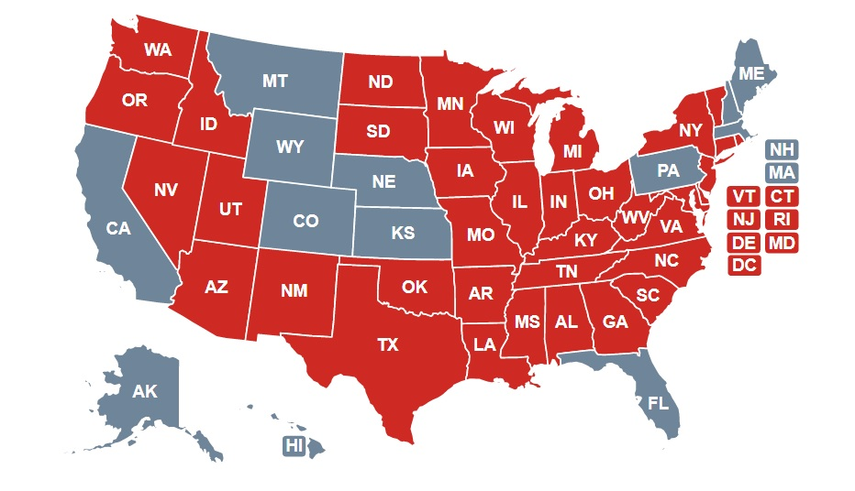
CPR in Schools
South Dakota was 36th state to require hands-only CPR in required curriculum before graduation
Became law July 1, 2017
Could train up to 10,000 students a year in bystander CPR and greatly enhance our emergency services capacity in South Dakota

Slide 57
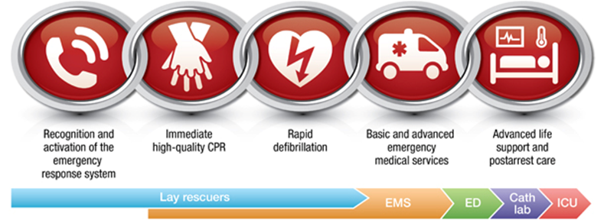
Cardiac-Ready Communities
Program designed to prepare communities to respond and assist to increase survival from a cardiac event occurring outside of the hospital setting
North Dakota, Montana, Minnesota have similar programs, SD gathering best practices
Notes:
Will discuss the different projects/ policies AHA is focused on and potential for collaboration with partners

Slide 58
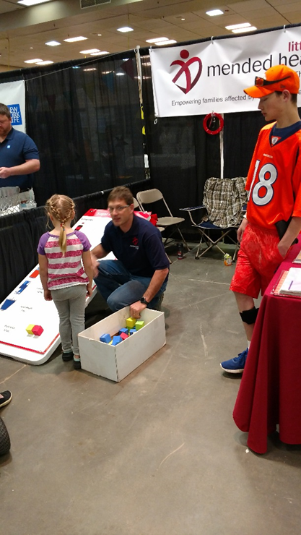

Healthy Living
Support efforts to increase active living and healthy eating through policy
Complete Streets, Safe Routes to School, bike safety laws
Increasing quality and quantity of physical activity in schools
Supporting school lunch standards
Notes:
Will discuss the different projects/ policies AHA is focused on and potential for collaboration with partners

Slide 59
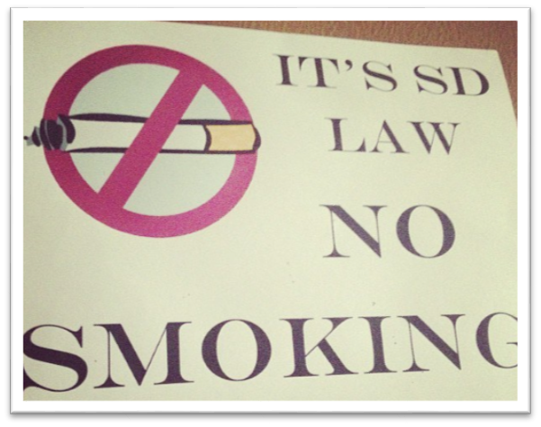
Tobacco-Free
Reduce tobacco use in South Dakota
Increasing price of tobacco products – 2006
Defending our smoke-free law – passed 2010
Working to ensure the US Food and Drug Administration has the authority to regulate tobacco, including e-cigarettes
Work annually in Pierre on enforcement and program funding
Notes:
Will discuss the different projects/ policies AHA is focused on and potential for collaboration with partners

Slide 60

1) Blood Pressure Strategies
Increase and sustain blood pressure control from 54% to over 70% through healthcare system participation in Target BP | IMPACT: 7-12.5M
Increase % of hypertensive patients that are self-monitoring through community and employer based SMBP programs (Y-BP and CCC) | IMPACT: 500K (Complementary)
Implement policy agenda to support increased hypertension control (home monitor coverage, Y-BP coverage, etc.)
Current Prevalence:
33 Million
Number of Adults 20+ with blood pressure >140/90 and/or BP medication use
(NHANES 13-14)
Health Equity Priority Populations
Highest prevalence: Black Adults (19% of total), Hispanic Adults (16% of total)
Impact on Health Disparities: Twin approach focus on FQHCs and community clinics
Notes:
TARGET BP
183.5M adults 20+ who have received care through outpatient settings
36.1% of adults in outpatient settings are hypertensive
Control rates in outpatient settings are 57.0%
If we reached 150 Million x 36.1% (hypertensive) x 13% improvement (57% to 70%) = 7.04 moved to control
If we reached 150 Million x 36.1% (hypertensive) x 23% improvement (57% to 80%) = 12.45 moved to control

Slide 61
Blood Pressure Ecosystem
Million Hearts
Healthcare System
Policy Agenda
(Target: BP)
Self Monitoring
Blood Pressure
(Y-BP, CCC, etc.)
Ad Council Stroke
AMA/AHA HCP Campaign
Ad Council Hypertension
Notes:
Reminder: The previous estimate for progress towards the CV health goal (based on 2011-2012 data) was 3.5%
When we compare our baseline NHANES 2007-2008 data to the latest 2013-2014 data, we observe the following movement:
The Good News
For adults and youth, both reductions in the poor category and improvement in the ideal category was observed for smoking, blood pressure, physical activity, and total cholesterol
The Mixed News
For physical activity and total cholesterol in youth, we are seeing increases in individuals in the ideal category but an unfavorable increase in the poor category.
Similarly, we are seeing a favorable decrease in the poor category but an unwanted increase in ideal for blood glucose in adults.
The Bad News:
We are seeing both an increase in poor and a decrease in ideal for BMI in youth and adults and in blood glucose for adults
NHANES dietary data will not be available until Dec 2016/Jan 2017
Additional Information: Two scenarios for the Healthy Diet Score were used to provide estimates for the change in % of individuals at poor, intermediate, ideal levels in NHANES 2013-2014.
Carry Forward Approach: No change in diet
Linear Trends: Estimate based on previous trends in prevalence (%) of individuals in poor, intermediate, ideal categories
Based these dietary, estimates for overall improvement in CV health is 4.6 (Carry Forward from 2011-2012) to 5.0% (based on historical trends in diet – statistical estimation)
In addition, these changes only begin to account for AHA’s and other’s work since setting the 2020 Impact Goal in 2010, given the time lag in available data from the CDC. One thing is clear: we have our work cut out for us to achieve the CV health portion of the 2020 Impact Goal, making 2017-2020 the critical period for moving the needle toward the 2020 Goal.

Slide 62


Nationally supported by Sanofi and Regeneron
& supporting the 2020 AHA/ASA Impact Goal,
Check. Change. Control. Cholesterol ™
will empower all Americans to better manage their cholesterol
through the knowledge, tools, and resources needed
to reduce their risk for cardiovascular disease.

Slide 63

Objectives
Increase adoption and utilization of cholesterol management guidelines through professional education and quality improvement programs.
Increase understanding of and adherence to evidence-based treatment guidelines through public and patient education.

Slide 64
National Cholesterol Initiative Goals
To set up a pilot program in an Integrated Delivery Network with 50 healthcare providers by summer 2018.
Within the pilot program, achieve a 10% improvement in clinical management of cholesterol and a 10% improvement in perceptions of self-management of cholesterol in patients with existing cardiovascular disease (CVD) and patients at high risk for CVD by November 2018.
10% improvement in clinical management | 10% improvement in perceptions of self-management
Sub-goal 1: Achieve a 10% increase in percentage of adult patients with existing atherosclerotic cardiovascular disease (ASCVD) or at high risk for the development of ASCVD who are prescribed statin therapy. (PQRS #438 + additional reporting for groups with ASCVD risk > 7.5%) Sub-goal 2: Achieve a 10% improvement in provider-reported utilization of lifestyle-based treatment practices for cholesterol management. | Sub-goal 3: Achieve a 10% improvement in self-reported patient outcomes focused on self-management of health conditions, including cholesterol.
Concurrent to the pilot effort, prepare for national population roll out launching in Spring 2018.
2020 Goal & Plan Alignment: Based on the pilot settings, the Center for Health Metrics & Evaluation is advising on scenarios to extrapolate the potential for impact of this clinical management measure nationally. This will guide our national scale strategy in alignment with the 2020 goal measure (total cholesterol) and the 2017-2020 plan.

Slide 65
Strategy: Increase public awareness, education and engagement of patients and family caregivers to improve understanding of cholesterol treatment and management.
Public Awareness, Patient Engagement & Empowerment
Actions Taken:
Conducted market research with patients to understand gaps in perceived understanding and knowledge to inform educational efforts, as well as to identify news hooks for media launch, ongoing media outreach and new content.
Planning is underway for consumer education campaign launch.
Conducted content audit of Heart.org/Cholesterol and began refresh of content and tools.
Next Steps:
Release refreshed content on Heart.org/Cholesterol in April 2017.
Conduct consumer media campaign launch and begin continuous outreach via owned, earned and paid media channels in April 2017.
Conduct Public Health Summit on April 11th 2017.
Develop post-summit action plan, distribute to summit participants and conduct ongoing follow-up with participants to inform future efforts and further reach and impact of the initiative.

Slide 66



Strategic Approach
Public Health Summit: Convene thought-leaders to discuss gaps in care to drive better cholesterol management.
Increase adoption and utilization of treatment guidelines through quality improvement programs and professional education.
Increase understanding of and adherence to evidence-based treatment guidelines through public and patient awareness and education.
Quality Improvement &
Professional Education
eCQM & PROM development
Pilot measures and quality improvement program in an Integrated Delivery Network
National rollout of measures and quality improvement program
Continuing education
Public Awareness & Patient Education/Empowerment
Informed by patient and provider market research
Awareness and educational messages deployed via a robust campaign

Slide 67


THANK YOU
AHA Contact:
toni.ford@heart.org

Slide 68
Tools and Resources
Online Tools
My Life Check
Heart Attack Risk Calculator
AHA’s Smoking Cessation Tools and Resources
AHA Healthy Workplace Food and Beverage Toolkit July 2016
Resources
EmPowered to Serve
Get With The Guidelines
Check.Change.Control
Target: BP

Slide 69
Discussion
Is there a program you were unaware of that you would like to explore further for implementation or application in the state?
On which topics would you like additional information?
Other questions

Slide 70


Contact Information
Megan Myers, SD Government Relations Director
  Sioux Falls
  605-261-7717
  megan.myers@heart.org
  @MeganAtHeart
Pam Miller, Regional Grassroots Advocacy Director
  Brookings
  605-310-3170
  pamela.miller@heart.org
  Facebook.com/southdakotaheart
  @sdakotaheart

Slide 71
CATERED LUNCH
Resume at 12:10pm

Slide 72
AFTERNOON BREAKOUTS
FACILITATED DISCUSSIONS
John Bartkus
SOUTH DAKOTA CARDIOVASCULAR COLLABORATIVE STRATEGIC PLAN 2017-2022, PARTNERS, PROGRAMS AND PERSONS THAT ALIGN
Group 1. Improve data collection
Group 2. Priority populations
Group 3. Continuum of care
Group 4. Prevention & management

Slide 73
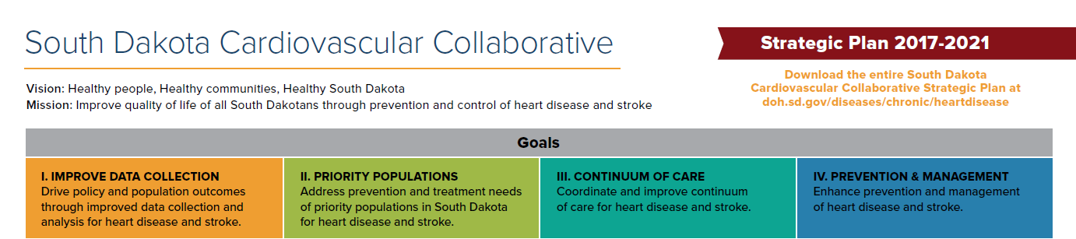

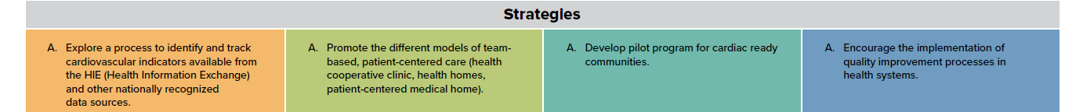
Priority Strategy

Slide 74
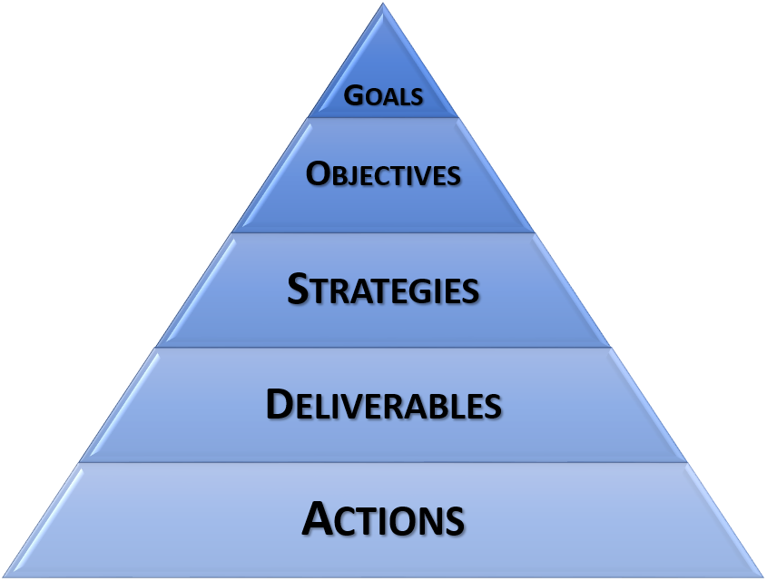
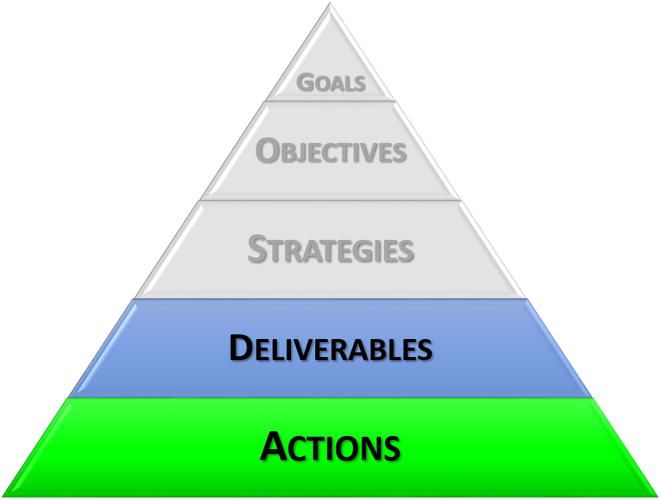
Workgroup Approach
Defining
Executing

Slide 75
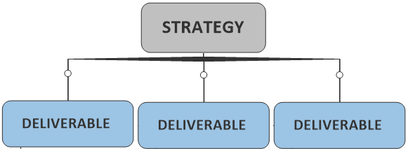

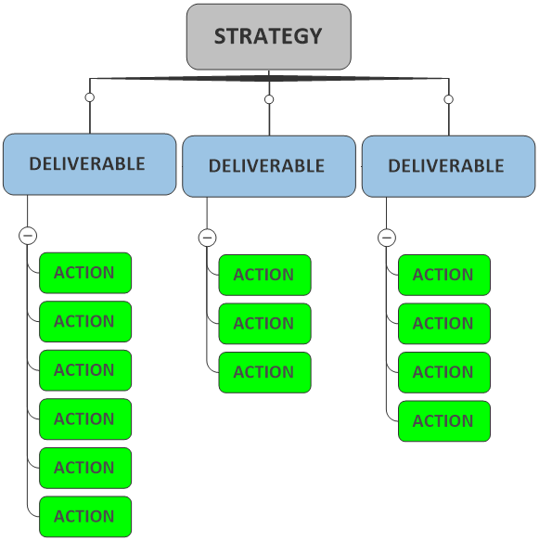
Workgroup Approach
Nouns
Tangible Outcomes
Verbs
Dates
Primary Owner
“Shepherd”

Slide 76
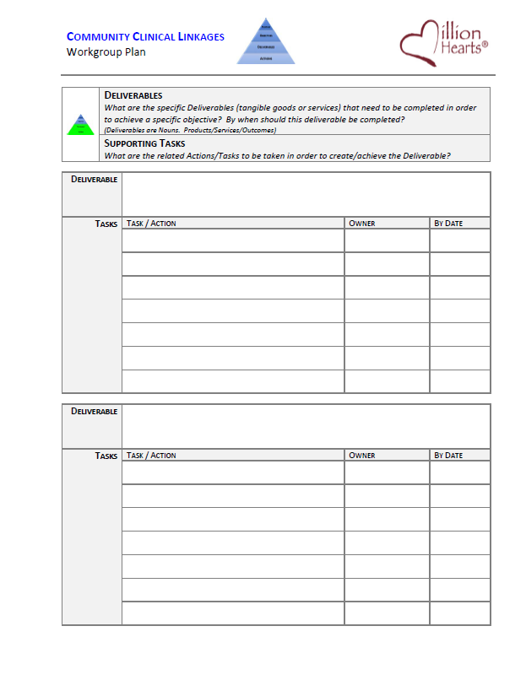
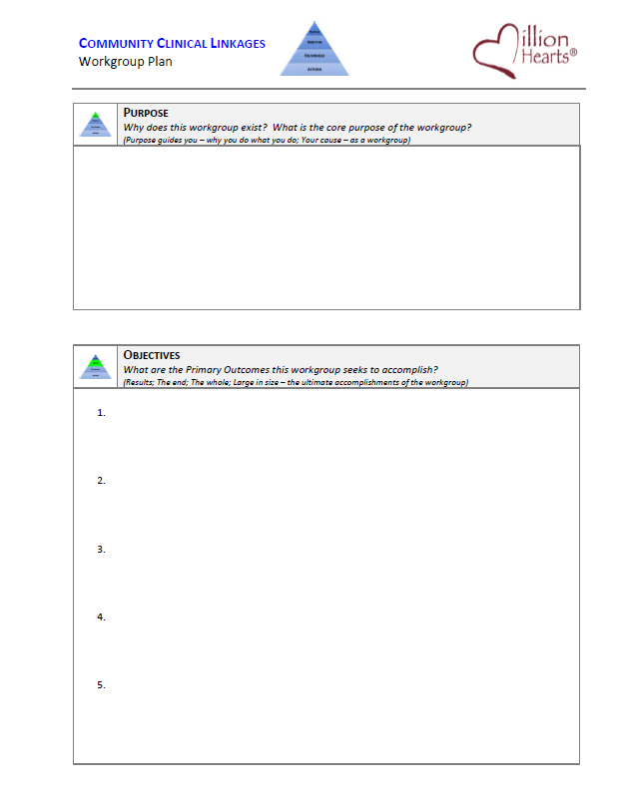
Workgroup Template…

Slide 77
Use this Conversation about an Action Plan as a Vehicle to Identify & Cultivate Alignment.

Slide 78
Final Logistics –for Afternoon Breakouts
1 IMPROVE DATA COLLECTION | 2 PRIORITY POPULATIONS | 3 CONTINUUM OF CARE | 4 PREVENTION & MANAGEMENT
Ashley Miller Stan Kogan Whitney Garney Robin Rinker Mallory Stasko | Kiley Hump Julia Schneider April Wallace Linda Stopp | Megan Myers Julie Harvill Mary Jo Garofoli | Katie Hill Miriam Patanian John Clymer Holly Arends
2:00pm – Groups provide “Report Outs” to the full team

Slide 79
REPORTS FROM BREAKOUTS
PLANS FOR FOLLOW-UP/NEXT INTERACTIONS
John Bartkus

Slide 80
EVALUATION AND FEEDBACK PROCESS
Whitney R. Garney, WRG Consulting

Slide 81
WRAP UP
April Wallace, Program Initiatives Manager, Million Hearts® Collaboration
ADJOURN

