Slide 1


Sleep = Superpower
Heart Club Meeting Game

Slide 2

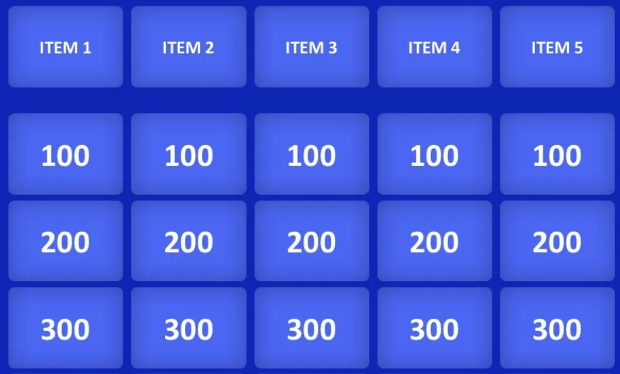
A Jeopardy-Style game
compete, learn and level up your health!
Setup:
Divide into 2–4 teams
Choose a host (you or another club leader)
Use a whiteboard, projector, or digital Jeopardy board (like JeopardyLabs.com)
Each team chooses a category and point value (100–300)
Teams must answer in the form of a question (“What is…”)

Slide 3
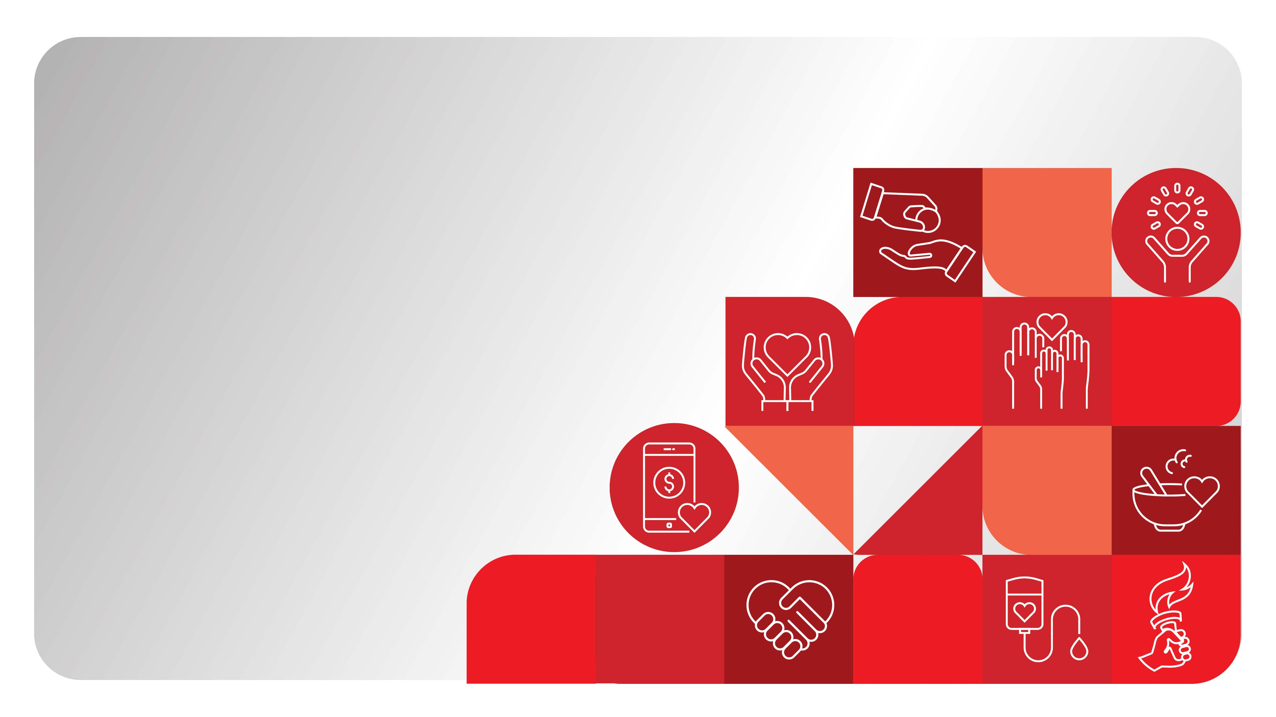
Categories
Dim it
Set it
Create it
Sleep & Health
Sleep Boosters

Slide 4
Dim it
100:
This type of light from screens messes with your body’s melatonin production.
What is blue light?
200:
This kind of phone app can help reduce blue light exposure at night.
What is a red filter or night mode app?
What does the firm want to achieve?
300:
True or False: You should keep your room as bright as possible to stay energized at night.
What is False?

Slide 5
Set it
100:
Doing this at the same time every day helps keep your internal clock on track.
What is going to bed and waking up?
200:
Setting this kind of alarm helps remind you to wind down, not just wake up.
What is a bedtime alarm?
What does the firm want to achieve?
300:
The body's internal clock is also known as this scientific term.
What is circadian rhythm?

Slide 6
Create it
100:
This relaxing activity involves soaking in warm water before bed.
What is taking a bath?
200:
Name one screen-free activity that’s great for winding down.
What is reading, journaling or meditating?
What does the firm want to achieve?
300:
You should spend how many minutes winding down before sleep?
What is 20–30 minutes?

Slide 7
Sleep & Health
100:
Poor sleep increases your risk for this mental health condition.
What is depression?
200:
Lack of sleep can raise your blood _________.
What is pressure?
What does the firm want to achieve?
300:
Sleep plays a role in this organ's function, responsible for memory and focus.
What is the brain?

Slide 8
Sleep Boosters
100:
This hormone, known as the “sleep hormone,” helps regulate your sleep.
What is melatonin?
200:
This natural immune system benefit is stronger with good sleep.
What is fighting off sickness / stronger immunity?
300:
What does the firm want to achieve?
Sleep improves your ability to do this in school and in life—includes memory, reasoning, and focus.
What is thinking/brain function?

Slide 9
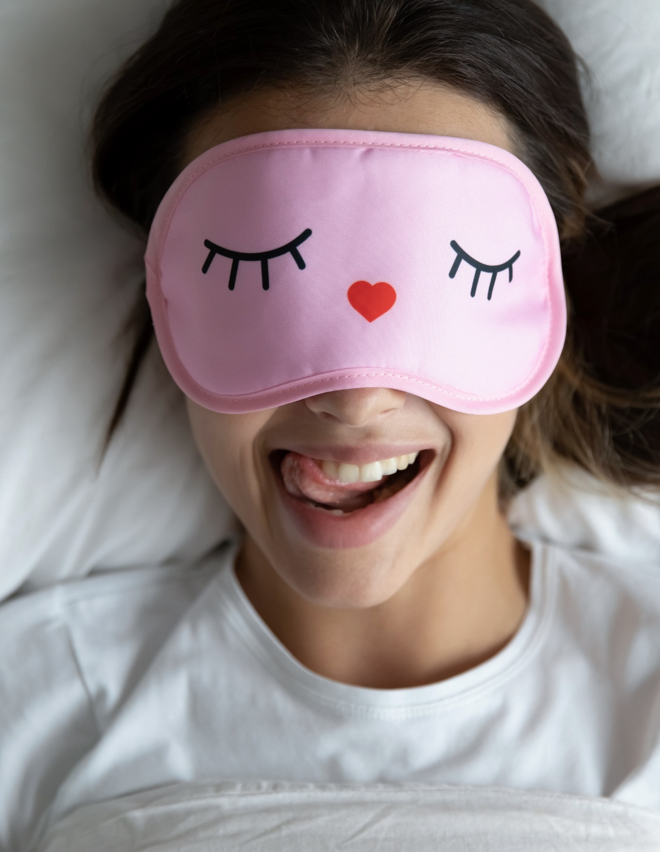

Final
Sleepdown Question
(optional)
Wager your points!
Poor sleep is called a "silent risk" for health because it increases your chance of developing these three chronic diseases without obvious symptoms.
What are heart disease, high blood pressure and diabetes (or high cholesterol)?

Slide 10
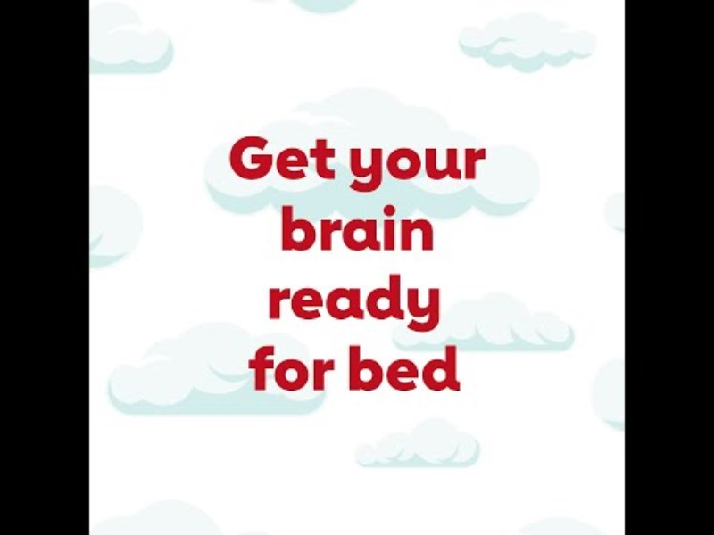
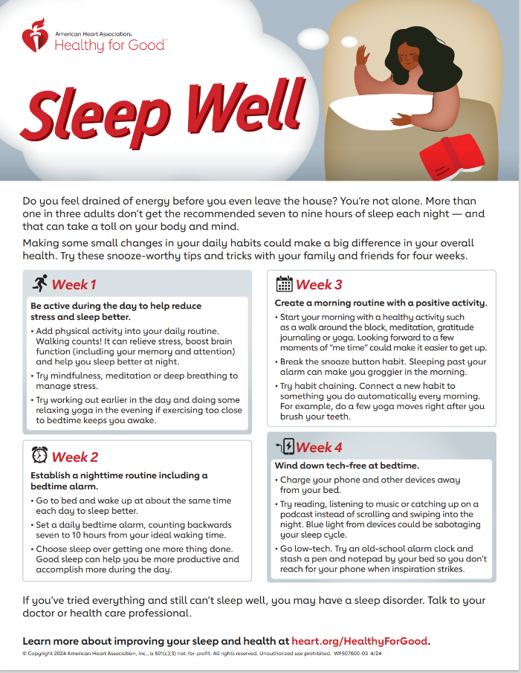
Watch this Video
Create your own sleep ritual!
Sleep Well

