Slide 1


Eat Smart
Daily
Easy Meal Prep &
Building Lifelong
Habits
Plus Host a Vision
Board Party!

Slide 2

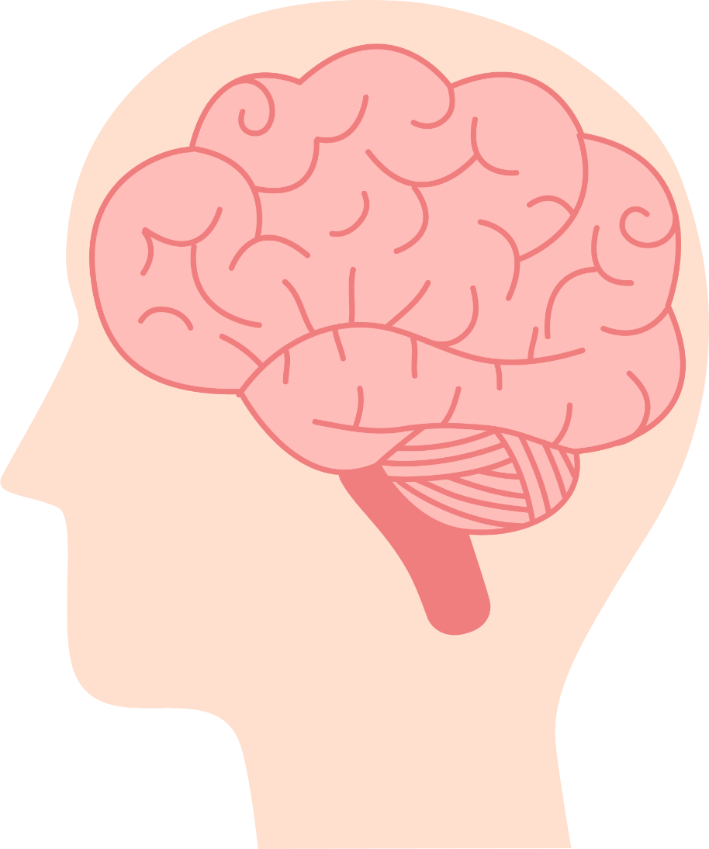
Why Healthy
Eating Matters
Boosts brain power & energy
Supports heart & mental health
Helps with focus, mood, & stress management
Saves money compared to eating out all the time

Slide 3


6 Minute Cooking Demo
Healthy & Easy Meal Prep Ideas to
Meal Prep 24 Healthy Meals in 1 Hour

Slide 4


Tips for Grocery Shopping
Learn how to read a nutrition label
Compare similar products → pick the one with less sodium, sugar & unhealthy fats
Look for the Heart-Check Mark to find heart-healthy options
Fresh, frozen, or canned (no added sugar/salt) veggies all work!
What does the firm want to achieve?

Slide 5
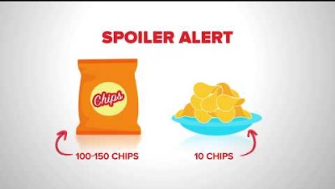
How to Read a Nutrition Label
What does the firm want to achieve?

Slide 6
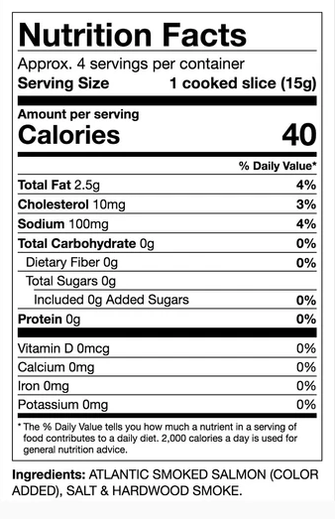
Nutrition Label Challenge Activity
Step 1: Look at the Nutrition Label.
Step 2: In your group, find and discuss:
● Serving Size — How much is one serving?
● Added Sugars — How many grams?
● Sodium — Is it high or low?
● Fats — Check for saturated & trans fats.
Step 3: Decide if this food is a “Go,” “Slow,” or “Whoa” food:
● Go: Eat often (healthy choice)
● Slow: Eat sometimes (moderation)
● Whoa: Eat rarely (less healthy)

Slide 7


Fad Diet vs. Healthy Eating
What is the Difference between
a Fad Diet and Healthy Eating?
Fad Diets: What Should You Believe?
● Fad diets = quick fixes, often restrictive
● Healthy eating = balanced, sustainable, variety of foods
● Don’t focus on “special” foods – aim for overall balance

Slide 8

Creating a Healthy Eating Pattern
Fill half your plate with fruits & veggies
Include whole grains, beans, legumes, nuts
Choose lean proteins (skinless poultry, fish, seafood, low-fat dairy)
Use plant-based oils (olive and avocado)
Limit: sweetened drinks, processed meats, salty & fried foods, full-fat dairy, coconut & palm oil
Avoid trans fats
What does the firm want to achieve?

Slide 9

Watch Portions
& Cook at Home
What does the firm want to achieve?
Keep portion sizes balanced
Cooking at home saves $$ and is usually healthier
Frozen/canned veggies & fruits are fine – just check for added sugar/salt
Find simple recipes at heart.org/recipes

Slide 10
Eating Disorders & Getting Help
Signs of disordered eating:
○ Obsessive calorie counting
○ Extreme food restriction or binge eating
○ Guilt after meals
Resources for help:
○ National Eating Disorders Helpline: 800-931-2237
○ Campus counseling & health services
○ NEDA.org for more info
What does the firm want to achieve?

Slide 11
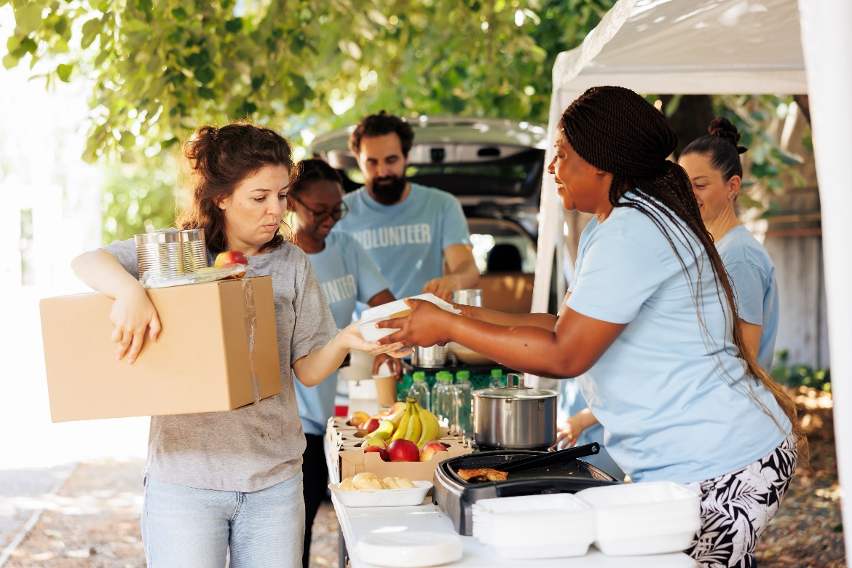
Food Assistance
Resources
Find Help with AHA
SNAP Benefits (EBT) – helps cover groceries
Campus Food Pantries – free resources for students
Local community programs & food banks
Visit feedingamerica.org to find help
What does the firm want to achieve?

Slide 12

In Need of Inspiration?
Look for the Heart-Check mark on packaged foods
Hundreds of easy recipes at heart.org/recipes
Small steps = long-term success!

Slide 13


Vision Board
Party 2026
Join us to set healthy intentions for the New Year!
Create a personalized wellness vision board
Set goals for heart health, fitness & self-care
Build community & motivation for 2026 and beyond
What does the firm want to achieve?

