Slide 1



Get to Know
Cholesterol
The Good and the Bad
Why it matters &
What you can do

Slide 2

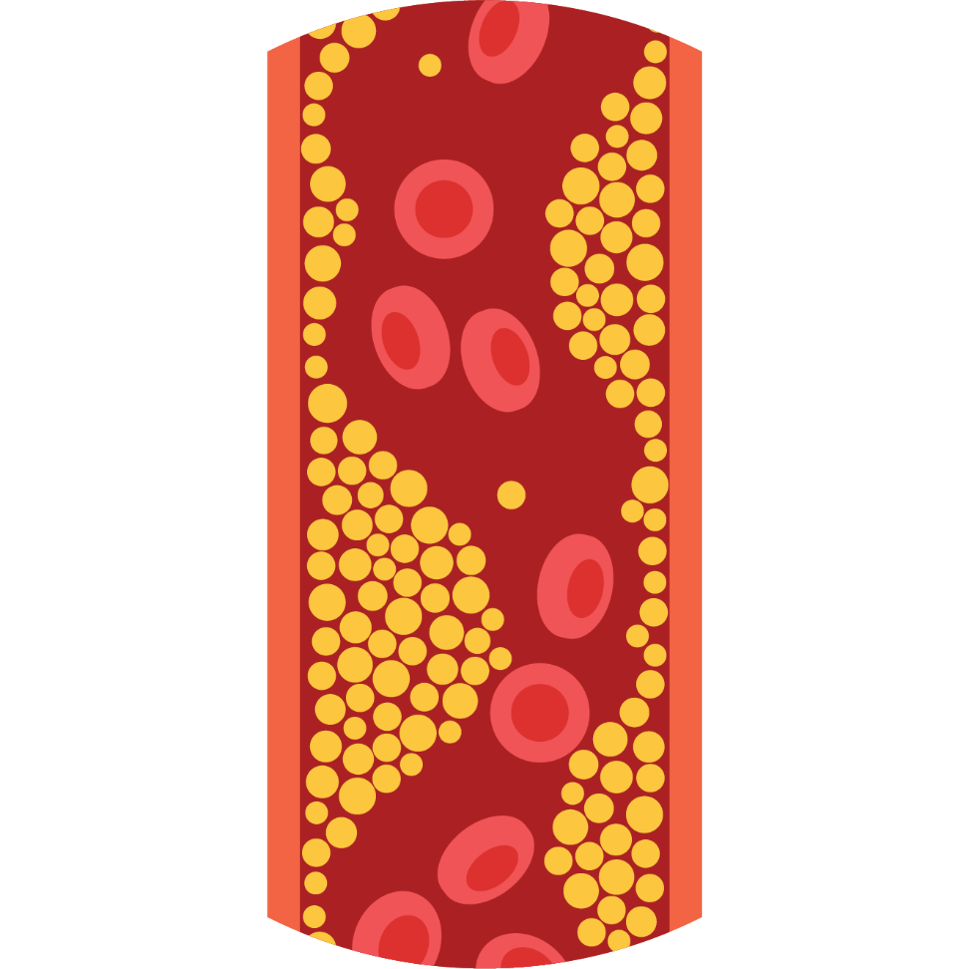
What is Cholesterol?
A fat-like substance from two sources: food & your body
Only found in animal-based foods
Travels in the blood via lipoproteins (LDL & HDL)
Too much can harm heart & brain health

Slide 3
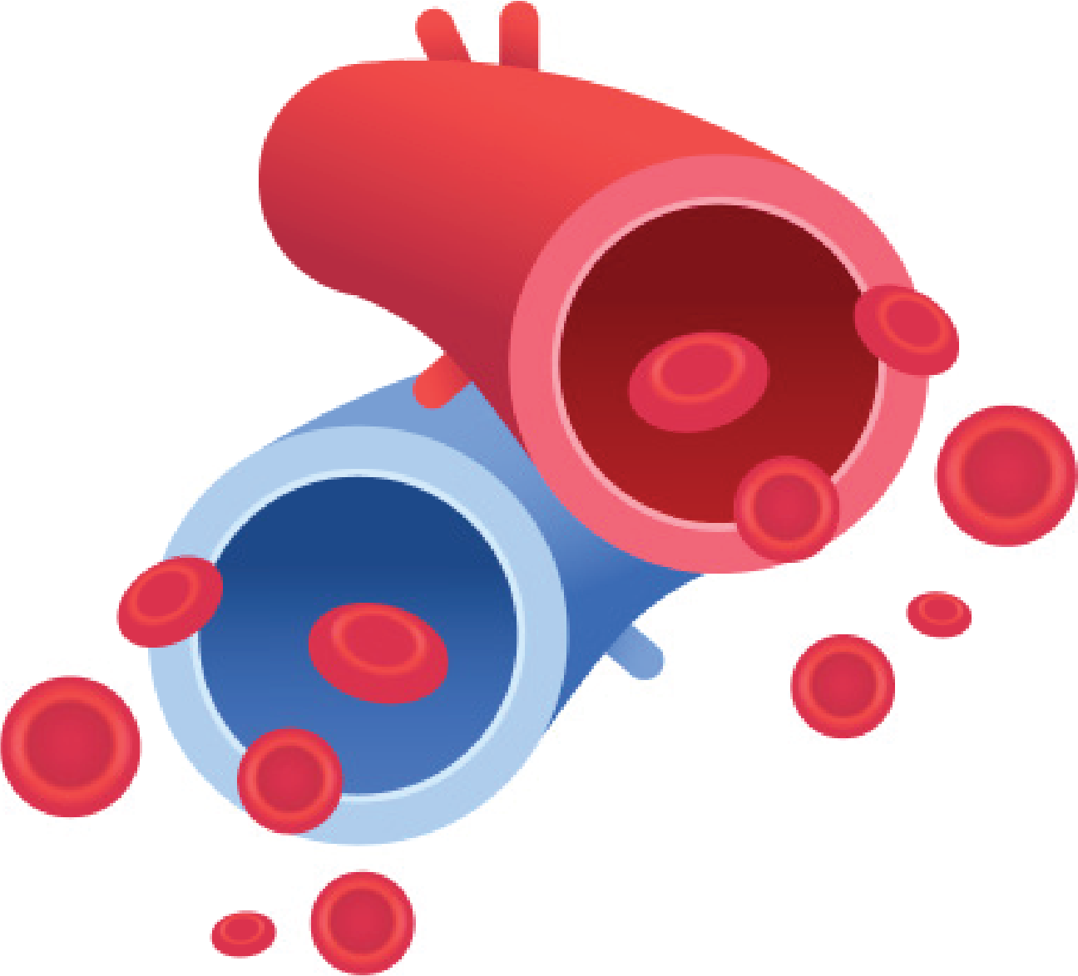
Good vs. Bad Cholesterol
LDL = Bad
Low-density lipoprotein
Causes plaque buildup in arteries → heart disease & stroke
HDL = Good
High-density lipoprotein
Helps remove LDL & keeps it from sticking to artery walls

Slide 4




Why
Cholesterol Matters?
High cholesterol increases risk for:
Heart disease
Stroke
Dementia,
like Alzheimer’s disease
Lowering cholesterol protects both heart & brain

Slide 5
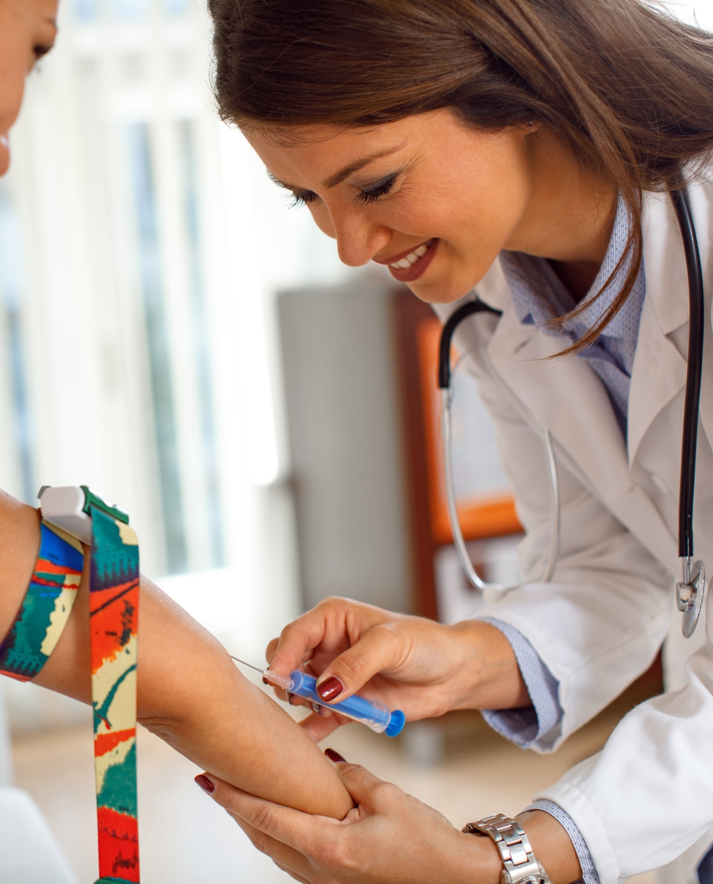
Track Your Levels
A simple blood test checks your cholesterol
Keep track of your numbers
If high, take steps to reduce it with lifestyle changes & medication if needed
What does the firm want to achieve?

Slide 6
Tips for Success
Eat Smart → fruits, veggies, whole grains, lean protein
Move More → exercise improves cholesterol & mood
Know Your Fats → choose olive oil, fatty fish, nuts over butter & fried foods
No Nicotine → smoking lowers good HDL & harms heart health
Take Medication if Prescribed → statins & other meds can help
What does the firm want to achieve?

Slide 7
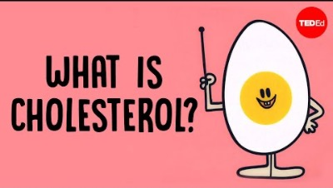
Watch this video.
What does the firm want to achieve?

Slide 8

Small Changes.
Big Impact.
Even modest lifestyle changes lower cholesterol
Every step you take protects your heart & brain for the future

Slide 9


National Walking Day
Wednesday, April 1, 2026
It’s no April Fool’s Joke! Walking just 20-minutes a day improves Mental and Physical Health!
This month build your plan to promote and celebrate #NationalWalkingDay and to move more in April.
What does the firm want to achieve?
Record a National Walking Day PSA Video with your Heart Club
Work with your school to organize and promote walking challenges for April 1st

