Slide 1


Sugar Smarts
Understand blood sugar and healthy swaps!

Slide 2


Understanding Blood Glucose (Sugar)
It serves as your body’s main source of energy and is important for the health of your brain, kidneys, and heart.
Low blood sugar → tired, dizzy, feel better after eating.
High blood sugar → can result from dehydration, infection, or long-term issues like prediabetes & diabetes.

Slide 3
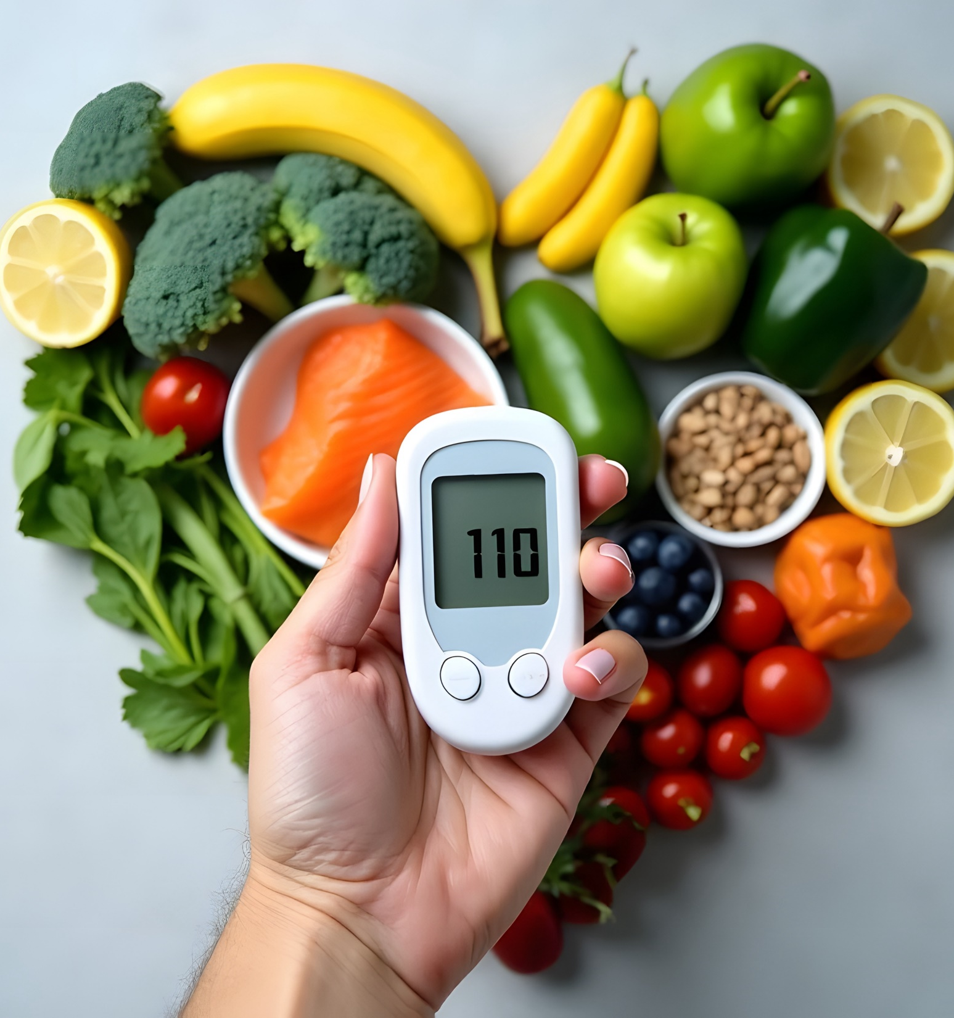

What is
Glucose (Sugar)?
Blood glucose is the sugar in your blood that gives your body energy. Your body gets it from the food you eat. It moves through your blood to give you energy.
Healthy habits like eating well and being active help keep it at the right level.

Slide 4
How much is TOO MUCH?
It all comes down to how fast sugars get absorbed. For example, your body spends more time digesting an apple than regular soda. The apple contains fiber, so the natural sugar absorbs more slowly. The added sugar in soda, however, hits your system all at once, absorbing sugars much more quickly.
A 12-ounce can of soda contains 10 teaspoons (42 grams) of added sugar — nearly double the recommended amount a day for women and more than the total daily amount for men. The American Heart Association recommends that men should consume no more than 9 teaspoons (36 grams or 150 calories) of added sugar per day. Women should consume no more than 6 teaspoons (25 grams or 100 calories) per day.

Slide 5

Tracking Blood Glucose (Sugar) Levels
Doctors check blood sugar during health checkups.
People living with diabetes may need to check it more often.
You can visit the American Heart Association website to learn more on both.
What does the firm want to achieve?

Slide 6
Fasting Blood Glucose (Sugar)
Fasting blood glucose is the amount of sugar in your blood after not eating or drinking anything other than water for at least 8 hours.
Levels less than 100 mg/dL – Normal
100–125 mg/dL – Prediabetes (higher risk of diabetes)
126+ mg/dL – Diabetes (higher risk of heart disease & stroke)
What does the firm want to achieve?

Slide 7
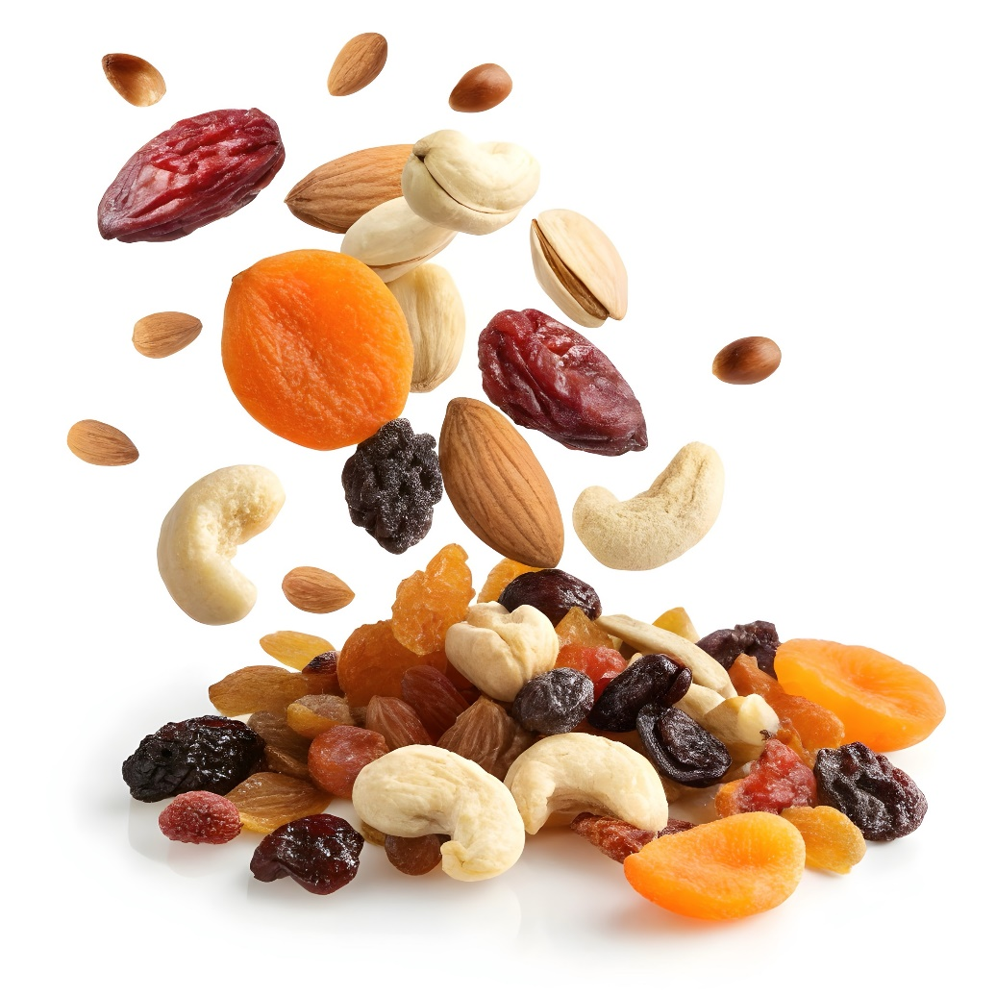
Healthier Snack & Drink Swaps
Soda → Sparkling water + lemon
Potato chips → Air-popped popcorn
Sugary parfaits → Greek yogurt + fruit
Energy drinks → Unsweetened tea
Candy bars → Trail mix (nuts & seeds)

Slide 8

Tips for Healthy Blood Glucose (Sugar)
Eat Smart → veggies, fruits, whole grains, beans, nuts, lean protein. Drink water instead of sugary drinks.
Move More → exercise lowers risk & helps manage diabetes.
Manage Weight → stay at a healthy weight with help from your doctor.
No Nicotine → avoid smoking, vaping, or secondhand smoke.
What does the firm want to achieve?

Slide 9

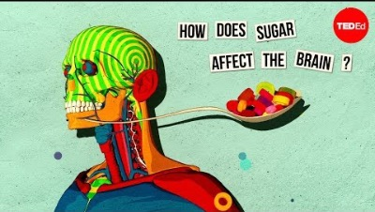
What does the firm want to achieve?
The link between diabetes and heart health
How sugar affects the brain

Slide 10
Kahoot Quiz:
Guess the Hidden Sugar!

Slide 11
How to Upload
1. Go to Kahoot.com
2. Click Create → New Kahoot
3. Copy/paste each question with answer choices.
4. Select the correct answer ✅ for each.
5. Add images (like a Coke bottle, Frappuccino, etc.) for extra engagement.
What does the firm want to achieve?

Slide 12
Q1. True or False: Glucose and
Sugar are the same thing?
✅ True
False
(Reveal fact: Yes, they are.)
What does the firm want to achieve?

Slide 13
Q2. How many teaspoons of sugar are in a 20oz bottle of Coca-Cola?
5 tsp
9 tsp
✅ 16 tsp (~65g)
20 tsp
(Reveal fact: That’s more than the daily recommended sugar for adults!)
What does the firm want to achieve?

Slide 14
Q3. Which has MORE sugar?
1 serving of Frosted Flakes
✅ 1 container of flavored yogurt
1 slice of white bread
1 apple
(Reveal fact: (Reveal fact: Flavored yogurt can have more sugar than some desserts!)

Slide 15
Q4. How many teaspoons of sugar are in a 16 oz Monster Energy Drink?
5 tsp
✅ 13 tsp (~54g)
9 tsp
17 tsp
(Reveal fact: That’s more than a can of soda!)

Slide 16
Q5. True or False: A 20 oz sports drink has more sugar than a
glazed donut.
✅ True
False
(Reveal fact: A sports drink ~34g vs. a glazed donut ~12g.)

Slide 17
Q6. Which drink has the LEAST sugar?
Sweet tea (16 oz)
✅ Unsweetened iced tea
Lemonade (16 oz)
Orange juice (12 oz)
(Reveal fact: Many “healthy” drinks are loaded with hidden sugars!)

Slide 18
Q7. How much sugar is in a 12 oz can of Red Bull?
12g
✅ 27g (~7 tsp)
35g
42g
(Reveal fact: Almost half your daily limit in one can!)

Slide 19
Q8. Which has MORE sugar?
✅ A medium McDonald’s Sweet Tea (~38g)
A chocolate chip cookie (~15g)
(Reveal fact: Sweet tea can have 2–3x more sugar than a cookie.)

Slide 20
Q9. What is the daily recommended added sugar intake for men?
12 tsp
6 tsp
8 tsp
✅ 9 tsp

Slide 21
Q9. What is the daily recommended added sugar intake for women?
12 tsp
✅ 6 tsp
8 tsp
10 tsp

