Slide 1


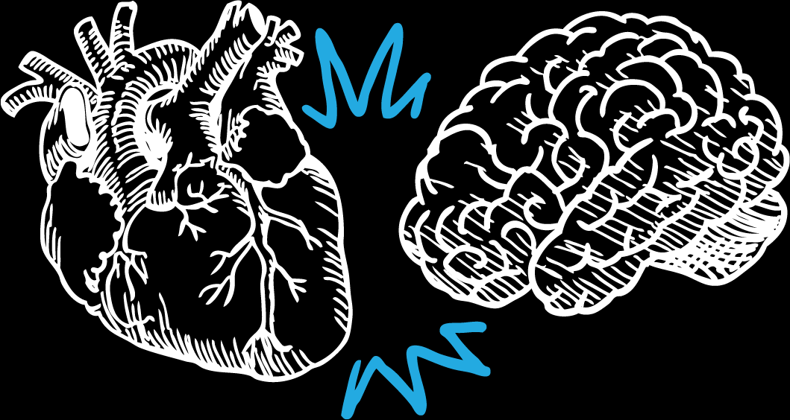
Pressure Check
Know your numbers & Connect with Experts

Slide 2


What is Blood Pressure?
First, let’s define high blood pressure. When your heart beats, it pumps blood into your blood vessels. This creates pressure against the blood vessel walls. This blood pressure causes your blood to flow to all parts of your body. High blood pressure, also known as hypertension, is when your blood pressure is consistently too high.
What’s most important to understand is that
high blood pressure can lead to health problems, including heart disease and stroke.

Slide 3
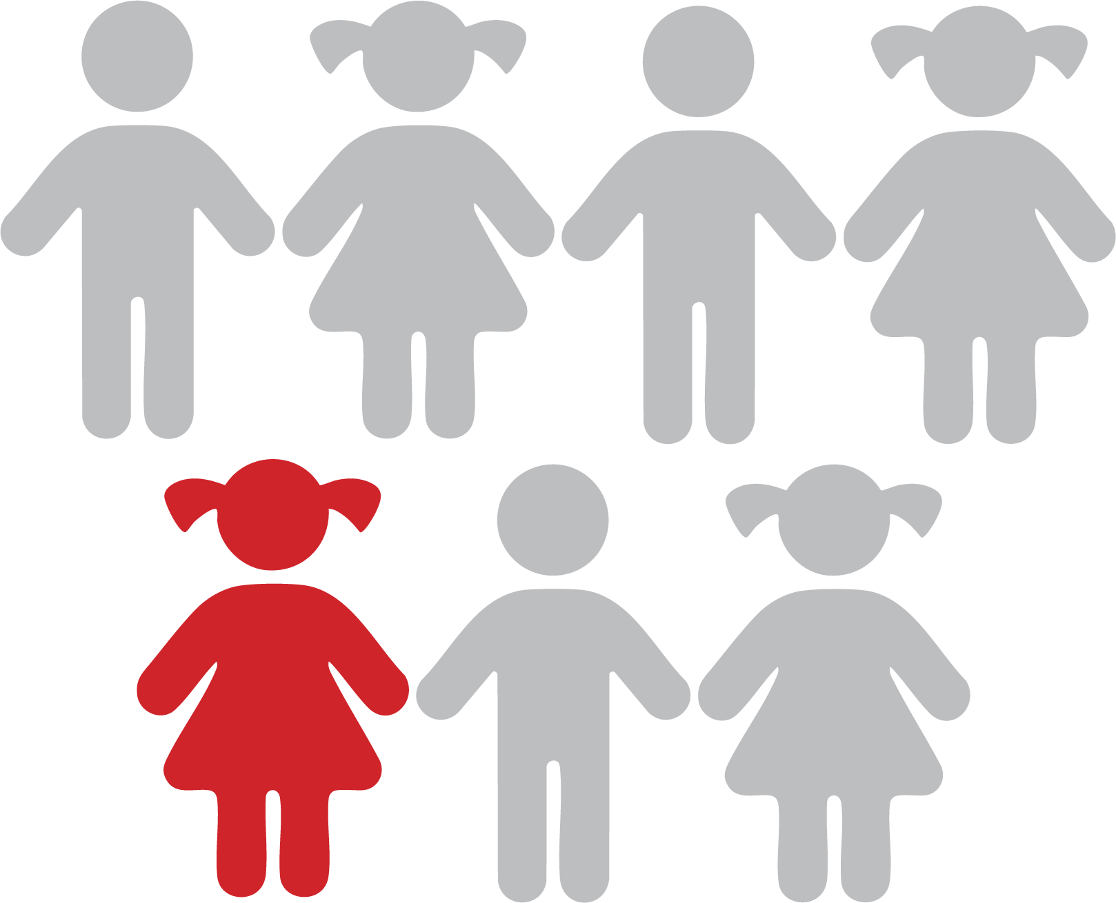
Why Should You Care?
According to the
American Heart Association,
1 in 7 kids
in US may have blood pressure
that's higher than normal

Slide 4
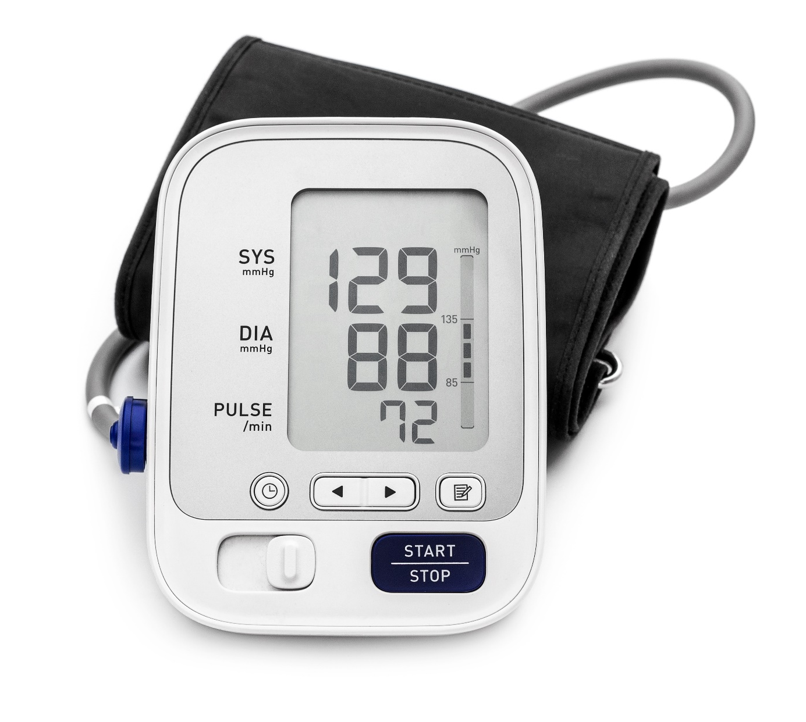

High blood pressure is one of the most common health problems – and there are things you can do to change it, which we will review in this health lesson.
The reason this is so important is because, when left untreated, high blood pressure can lead to heart disease, heart failure, atrial fibrillation, stroke, dementia, chronic kidney disease and even vision loss.
This is why it’s so important to check your blood pressure often, and if you do have high blood pressure, learning to manage it—it can save your life.

Slide 5

Things that put you at risk that you can't change: Family history, age, gender, race/ ethnicity , chronic kidney disease and obstructive sleep apnea. All these things can make you more at risk to high blood pressure, and even though you can’t change any of them, it’s important to know.
One of the key points I want to highlight is family history. Not everyone is comfortable talking to their family about health issues, but it can save your life, so next time you talk to your family- make sure to make health a top priority.
What does the firm want to achieve?

Slide 6
Things that put you at risk that you have control over: Also known as manageable risk factors because people have the power to make these changes.
AVOID
LIMIT
MANAGE
Some anti-inflammatory drugs (e.g., NSAIDs such as ibuprofen)
Herbal supplements such as
St. John’s Wort
Recreational Drugs
Caffeine (Avoid more than 1 cup daily in patients with severe uncontrolled hypertension)
Acetaminophen (like Tylenol- to less than 4 grams/day)
Decongestants - Use for shortest duration possible and avoid in severe or uncontrolled Hypertension
Diabetes management
Being obese or overweight
High cholesterol
Unhealthy diet
Not being physically active
Think about the things you see on this list and how they relate to your life. Remember, the important thing to remember is that you can improve these things.
What does the firm want to achieve?

Slide 7
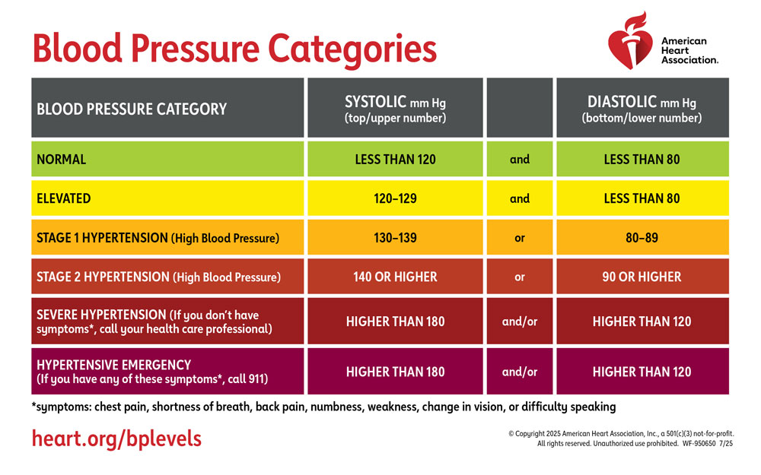

Know Your Numbers
What does the firm want to achieve?

Slide 8

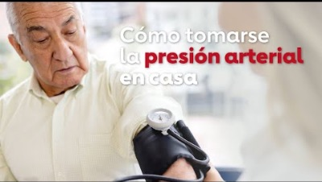
How to Take Your Blood Pressure
English
Spanish

Slide 9
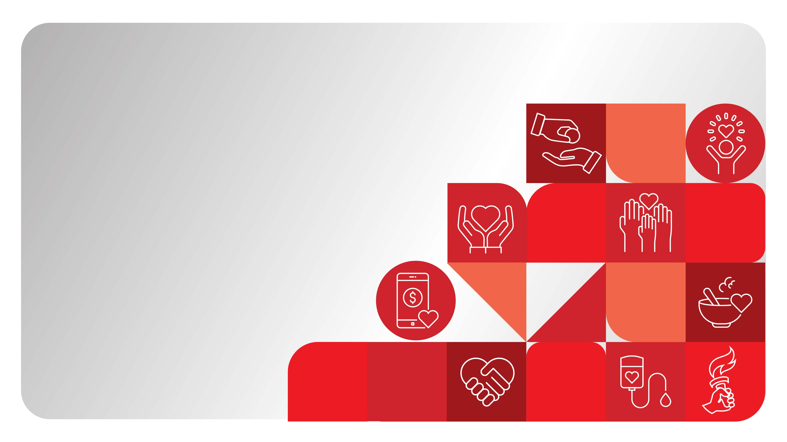
4 Health Behaviors
You Can Do:
No smoking or vaping
Get a healthy amount of sleep
Eat healthier
And move more

Slide 10
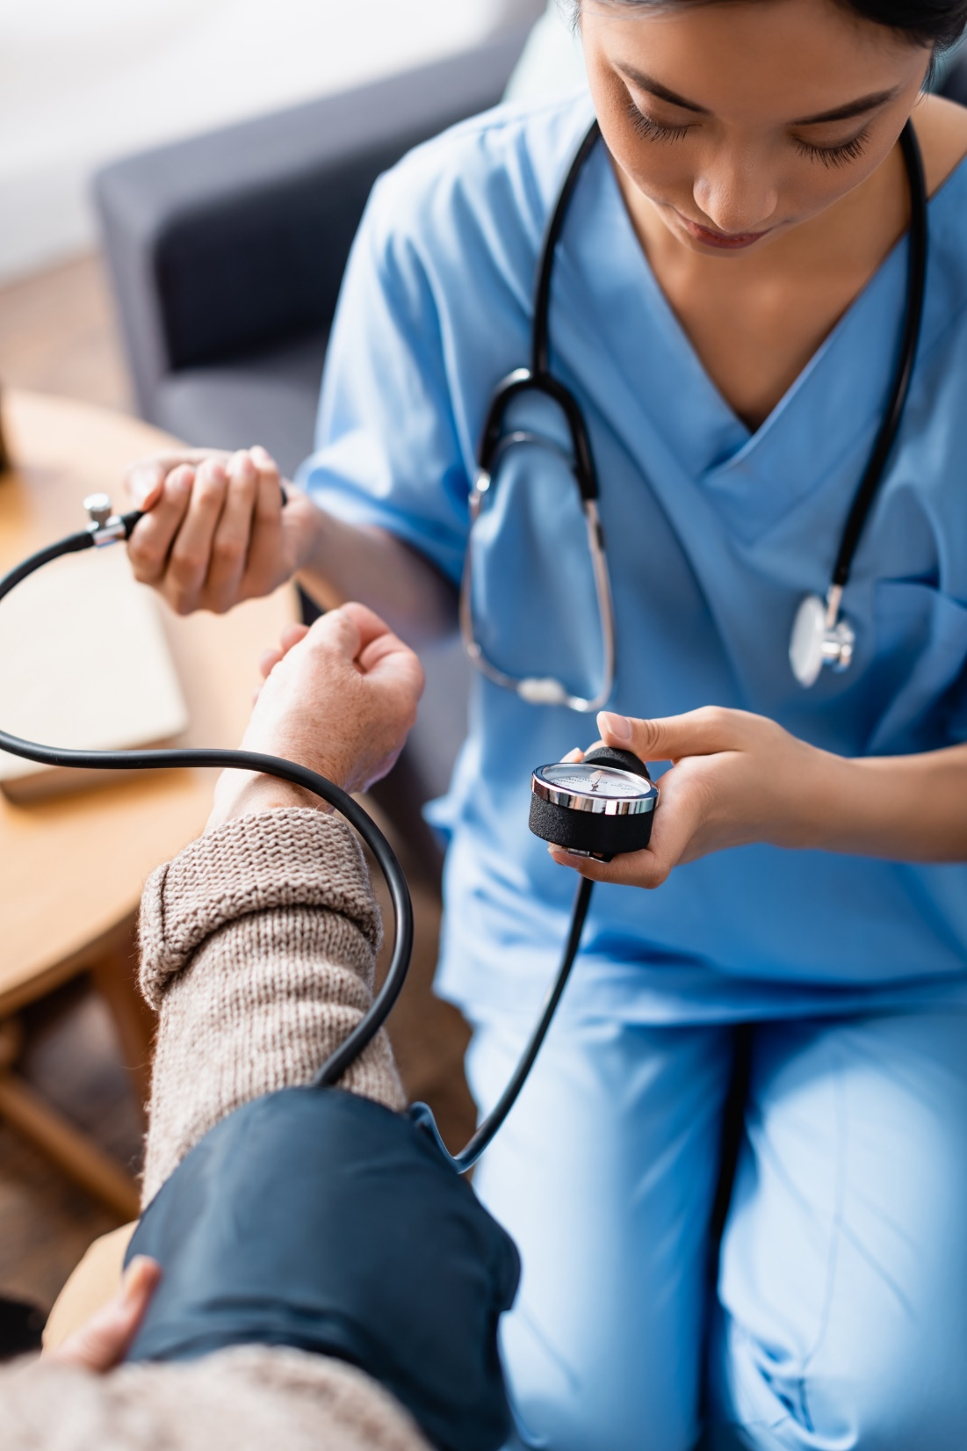
Activity:
Invite nurse or coach to demonstrate how to take your BP
What does the firm want to achieve?

Slide 11
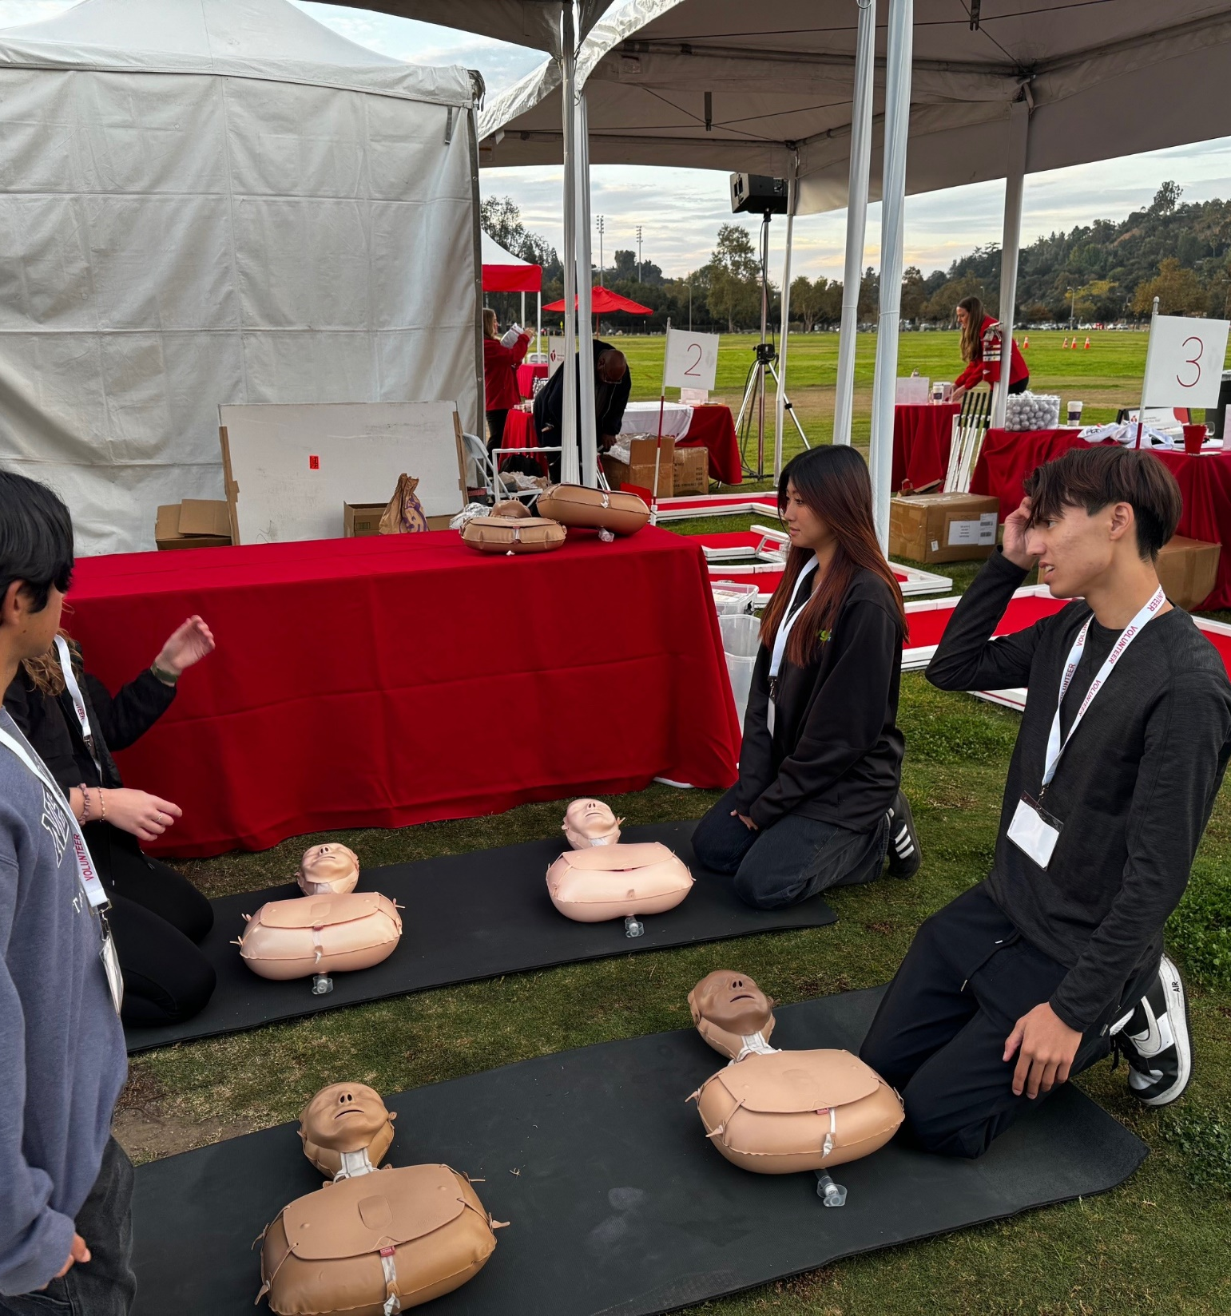
Extra
Activity:
Invite local fire department to do both BP and CPR education
What does the firm want to achieve?

