Slide 1




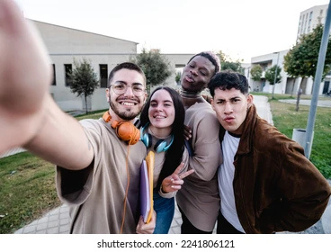



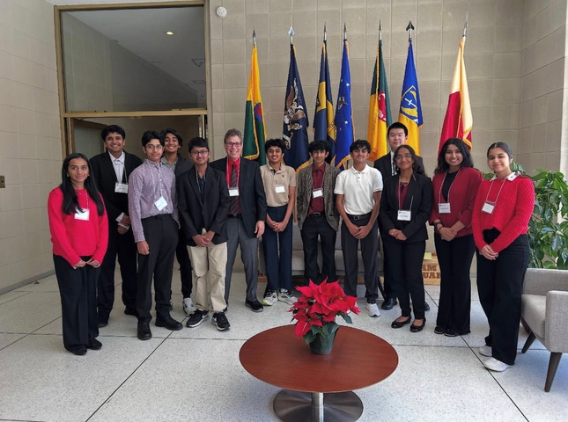
YOUR HEART CAN MAKE AN IMPACT
Join or start a Heart Club at your school!

Slide 2


WHAT IS HEART CLUB?
A student-led club that:
  Raises awareness about heart disease & stroke
  Promotes mental & physical well-being
  Volunteers to make an impact
  Advocates for healthier communities
  Fundraises to support lifesaving work
A movement to save lives, inspire change and raise awareness!

Slide 3

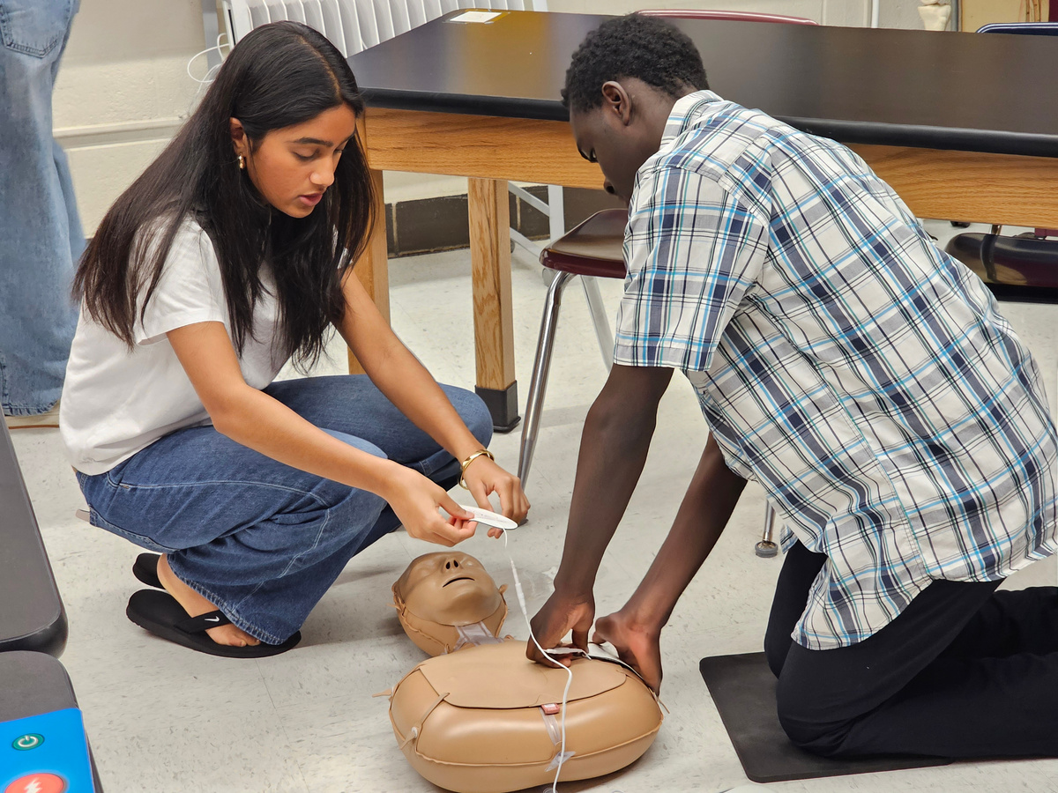
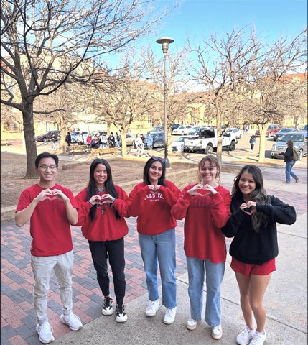
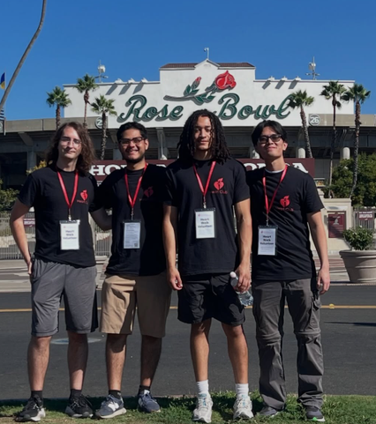
HEART CLUBS IN ACTION
Leadership
Alliance Academy for Innovation (GA) spoke with lawmakers about policies that help build healthier communities.
Impact
George Washington High School (WV) led Hands-Only CPR and AED demonstrations for students and staff.
Well-Being
The Texas Tech Heart Club turned the campus red on National Wear Red Day to raise awareness for heart disease, the #1 killer of women.
Fundraising
University of Southern California supported the Heart Walk at the Rose Bowl in Los Angeles.

Slide 4
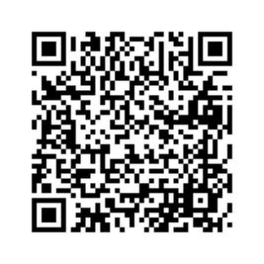
WHY JOIN?
THE NEXT STEPS:
  Earn community service hours
  Gain leadership & real-world experience
  Stand out on college and job applications
  Network with 35M+ volunteers nationwide
  Make a real difference in your school & community
  Find out if there is a club at your school! Email: HeartClub@heart.org
  To start a new club, secure a faculty or staff advisor
  Submit the Heart Club registration form
Scan the QR code to learn more about Heart Clubs!

