Slide 1
Downloadable
Social Media Posts
For Atrial Fibrillation Awareness Month
September 2022
Right click images to “save as” and post on your own social media accounts.

Slide 2
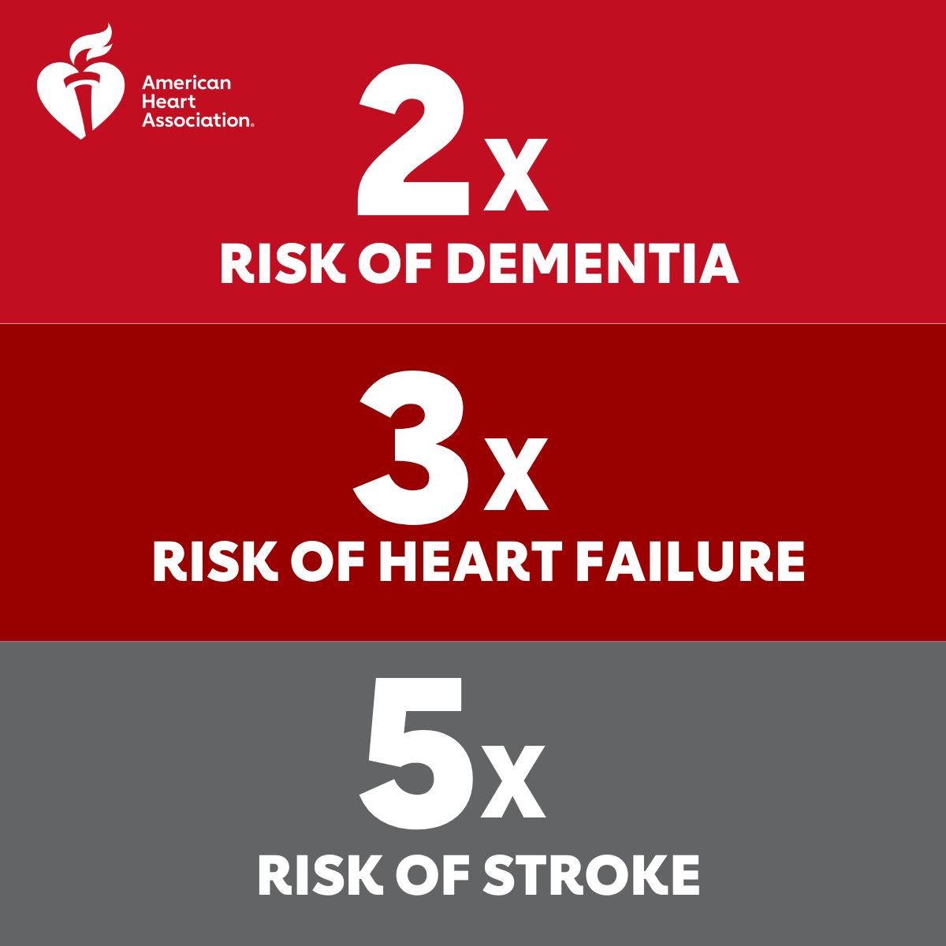
Post #1
People with Atrial Fibrillation #AFib experience higher risk factors than their counterparts. With AFib numbers growing in the US, it’s important to understand how to treat and prevent it. Learn more: heart.org/afibmonth22

Slide 3
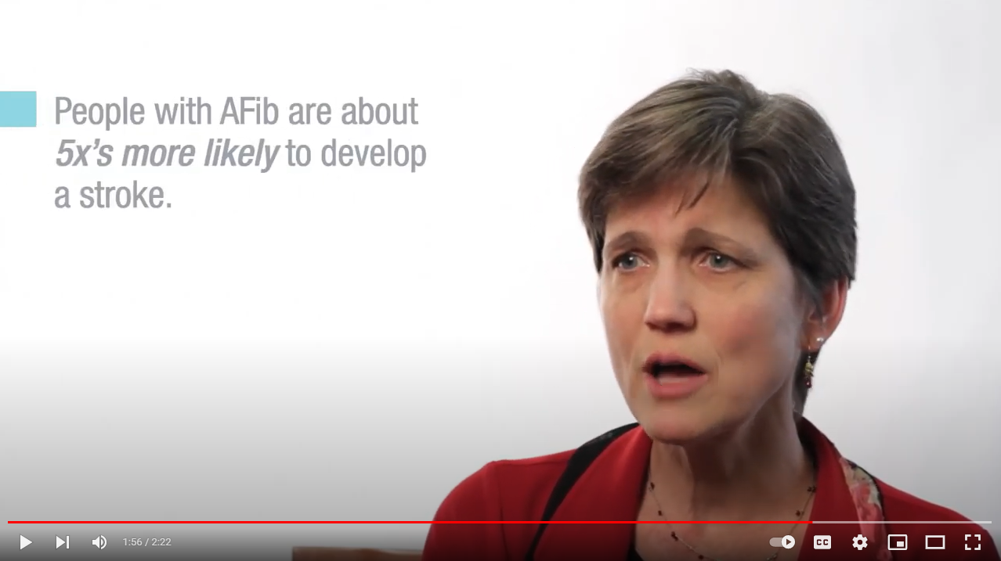
Post #2
The number of #AFib patients in the US is growing significantly. Join The American Heart Association for professional education and resources during AFib Awareness Month. heart.org/afibmonth22
Video in Post: https://www.youtube.com/watch?v=NzVXOdvonCw&t=140s

Slide 4
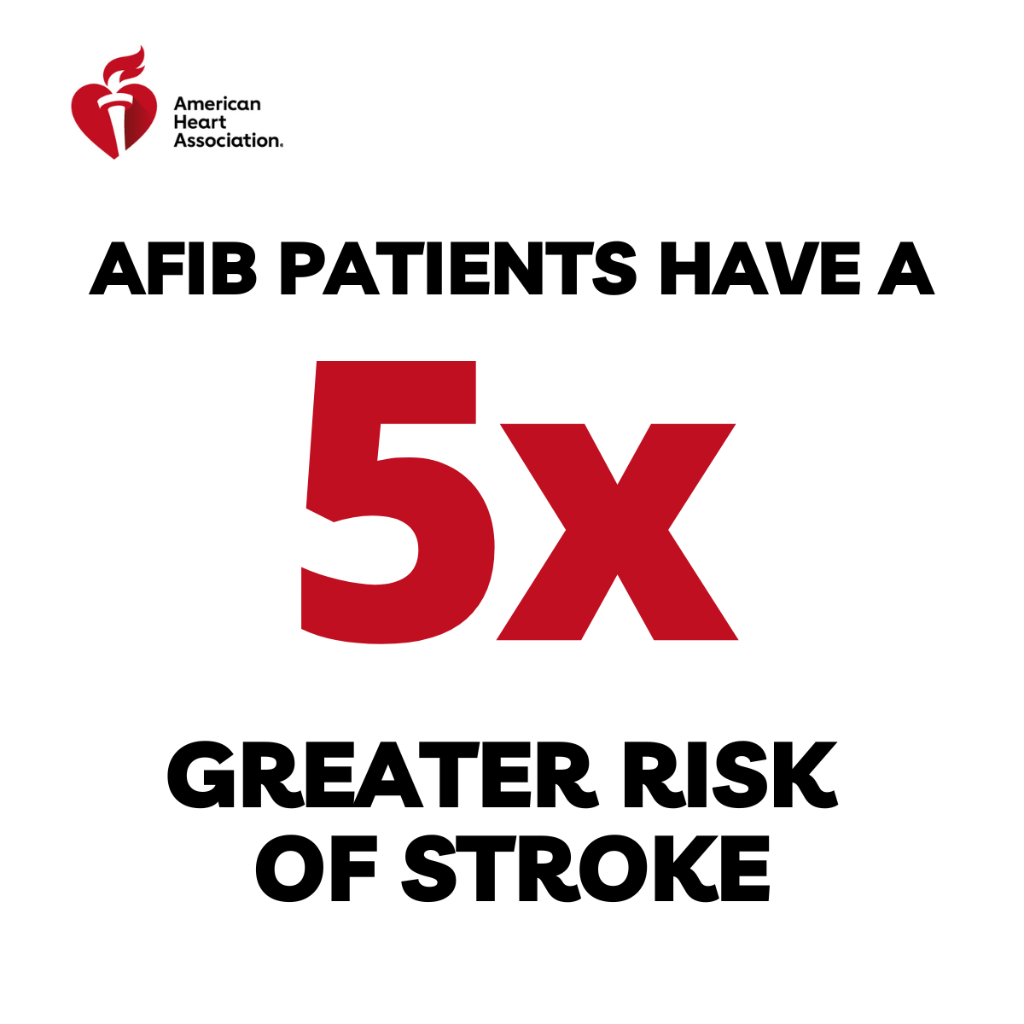
Post #3
It’s estimated that 12.1 million people in the US will have #AFib in 2030. Learn more: heart.org/afibmonth22

Slide 5
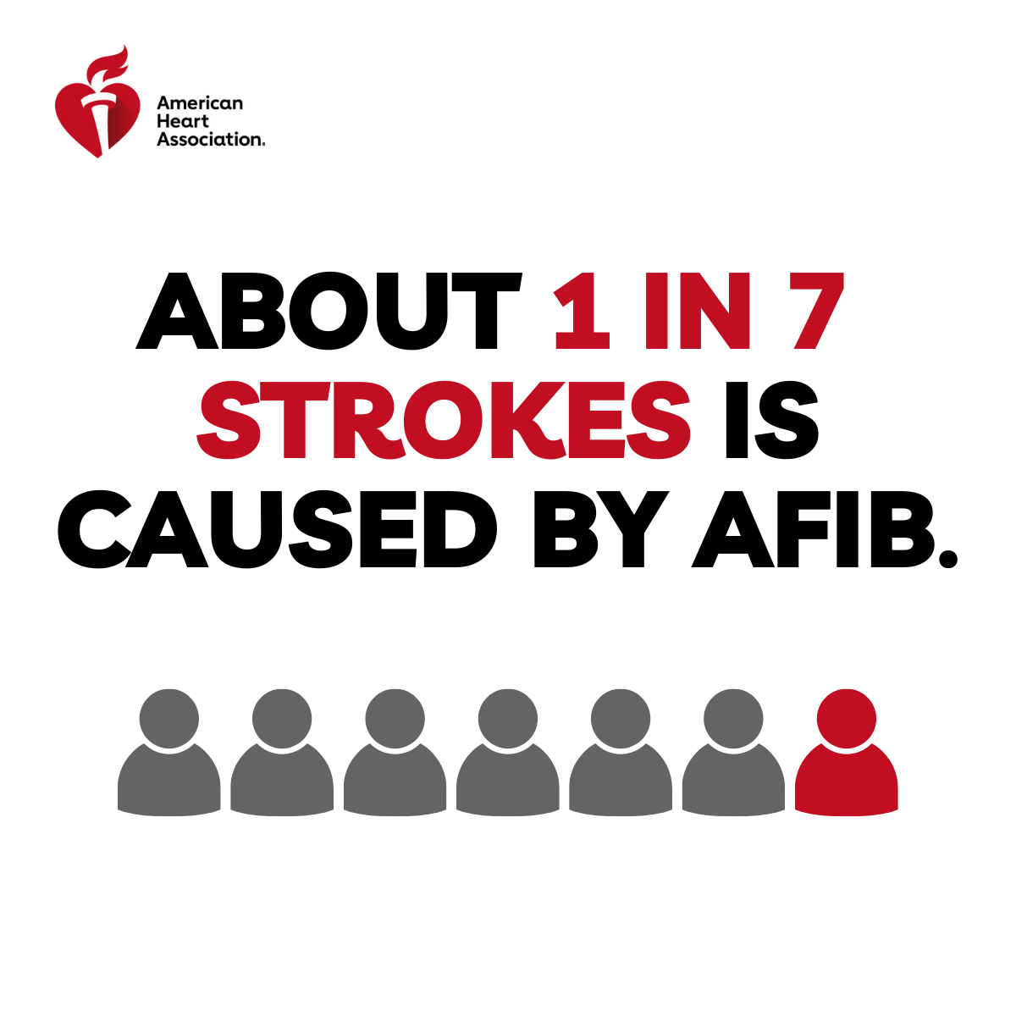
Post #4
Strokes caused by #AFib tend to be more severe than strokes with other underlying causes. It’s time to focus on AFib prevention as Stroke prevention. heart.org/afibmonth22

